Slide 1
Unit 1 - Introduction to Matter
Chapter 1 - The World of Physical Science

Slide 2
Section 1 – Exploring Physical Science
Physical Science – Study of matter and energy.
Chemistry – studying all forms of matter and how they interact
Physics – Like chemistry physics deals with matter but unlike chemistry physics is mostly concerned with energy and how it affects matter
Physical Science is all around you (p. 9)

Slide 3
Section 2 – Using the Scientific Method
Scientific Method – series of steps that scientists use to answer questions and solve problems.
Observation – any use of the senses to gather information

Slide 4
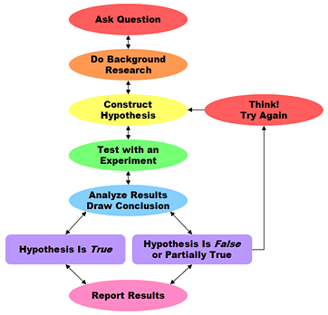
Steps of the Scientific Method
Ask a question – What type of dinosaur did these bones come from?

Slide 5
Steps of the Scientific Method
Form a Hypothesis – Hypothesis is a possible answer or explanation to the question (educated guess). Have to be able to test it – These bones came from a new dinosaur

Slide 6
Steps of the Scientific Method
Test the hypothesis – Scientists must conduct a controlled experiment that tests only one variable
Variable – the factor that changes
Most scientists also use observation instead of trying to control nature
Compare bones to known dinosaurs

Slide 7
Steps of the Scientific Method
Analyze the results – Look at the results once testing in finished. Create tables or graphs.
Bones did not match any dinosaurs

Slide 8
Steps of the Scientific Method
Draw conclusions – Did the test results match the hypothesis formed. If not another hypothesis needs to be formed or you could check your experiment for errors, if so then your conclusion may be correct
The dinosaur bones were indeed from a new species

Slide 9
Steps of the Scientific Method
Communicate results – Scientists must be able to reproduce the results and check each other’s work. Science grows with the sharing of information.

Slide 10
Steps of the Scientific Method
Ask a question
Form a hypothesis
Test the hypothesis
Analyze the results
Draw Conclusions
Communicate Results

Slide 11
Scientific Laws –
Theories – unifying explanation for a broad range of hypotheses and observations that have been supported by testing
More complex than a hypothesis which is an educated guess
Theories can be changed based on new observations
Laws – laws are more concrete and are based on many experiments.
Laws tell you what happens not why something happens.
Laws tell you that you can expect the same thing to happen again

Slide 12
Section 3 – Using Models in Physical Science
What is a Model? – representation of an object or system
Used for making predictions and explaining observations
Easy to make and can be tested without building the real thing. Saves time and money

Slide 13
Three Major Types of Models
Physical models are models you can touch (airplanes)
Mathematical Models are made up of equations and data (weather)
Conceptual Models are systems of ideas in the form of theories
Theories are an explanation for hypotheses and observations that have been supported by testing

Slide 14
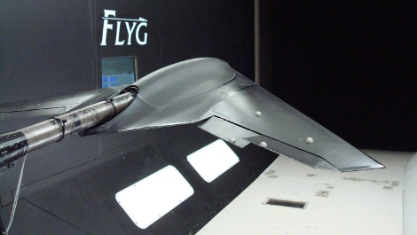
Experimental airplane

Slide 15
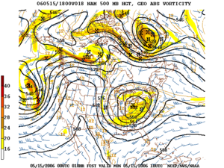

Slide 16
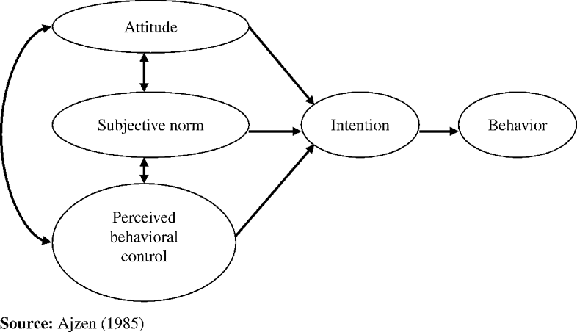
Theory of Behavior

Slide 17
Section 4 – Measurement and Safety
SI system
Most countries all over the world use the SI system –EXCEPT the USA
Scientists use the SI system so calculations can be used by others around the world
Based on the number ten just like money

Slide 18
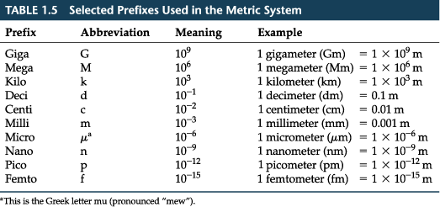
SI System
Measuring Length
Basic unit for measuring length is a meter (m)
Bigger units such as kilometers
Smaller units such as centimeters

Slide 19
SI System
Measuring Volume
Volume is the amount of space something occupies – based on the meter
Basic unit of measurement is the Liter (L) for liquid
A cubic meter (m^3) is equal to 1000 L. That means that 1,000 L of liquid would fit into a box that was 1 meter on each side

Slide 20
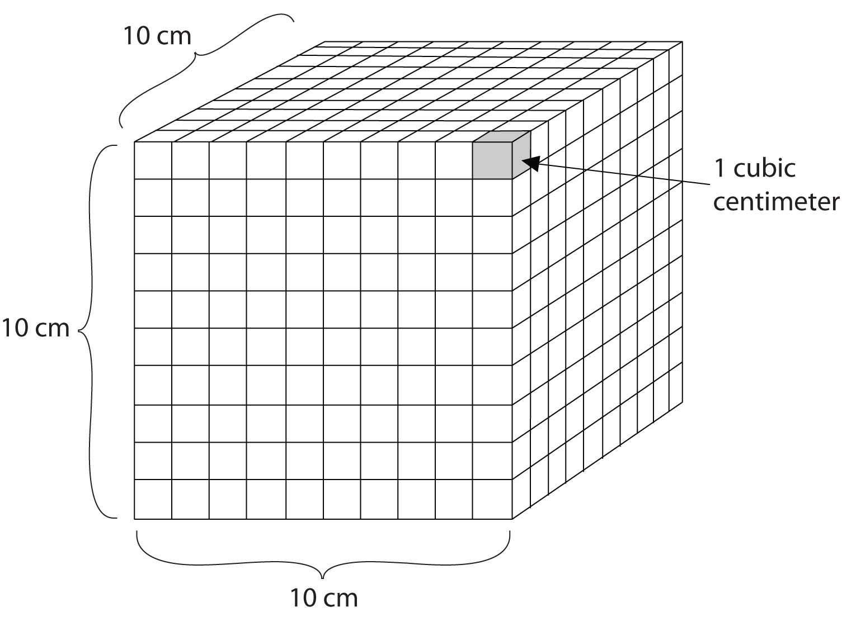
Measuring Volume
Volume is the amount of space something occupies – based on the meter
Basic unit of measurement is the Liter (L) for liquid
A cubic meter (m^3) is equal to 1000 L. That means that 1,000 L of liquid would fit into a box that was 1 meter on each side

Slide 21
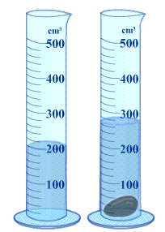
Measuring Volume
Take a look at the picture of the graduated cylinders on the left. (You might have noticed that the graduated cylinders are measuring in cm³. It actually doesn't make a difference because 1 cm³ is equal to 1 mL. It is just like using a graduated cylinder that has 500 mL.)
The cylinder starts with 200 cm³ of water.
When the rock is dropped in, the volume goes to approximately 270 cm³.
If you subtract 200 mL from 270 cm³ you get 70 cm³.
So the volume of the rock is 70 cm³

Slide 22
SI System
Measuring the Volume of Solids
Volume of a large solid is measured in cubic meters (m³)
Normally volume = length x width x height
For odd shaped objects use the “fat man in the bathtub approach”
How much water does the object displace
1 mL = 1 cm³

Slide 23
SI System
Mass
Mass is the amount of matter something is made of.
Basic unit of measurement is kilogram (kg)
Larger things are measured in metric tons such as ships
Smaller things measured in grams such as a peach
Remember mass is not weight!! Weight will change on Mars but mass will stay the same.
Weight is the measure of gravitational force between two objects

Slide 24
SI System
Temperature
Temperature is the measure of how hot or cold something is
Basic unit of measurement is Kelvin
Most scientists use Kelvin or Celsius ˚C
The USA uses Fahrenheit ˚F

Slide 25
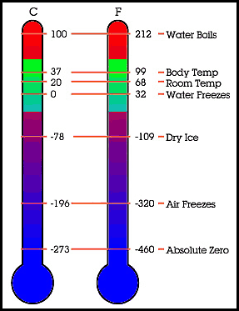

Slide 26
SI System
Area – A derived quantity which is a combination of other measurements, measure of how much surface an object has.
Area = length x width
Measured in square units – m², cm², m²
So if a rectangle is 4cm long and 6 cm wide how much area does it have?
4cm x 6cm = 24 cm²

Slide 27
SI System
Density – mass per unit volume
That means density is the amount of matter something has in a given space
D= suppose you want the density of a gear whose mass is 75 g and its volume is 20cm³ D= = 3.75 g/cm³
Two objects my look the same size but have different mass and density

Slide 28
Lab Safety
Never touch anything until you have instructions
Stay away from broken glass
Always wash hands after using chemicals
Wear protective clothing
Be smart about electricity
USE COMMON SENSE
ASK QUESTIONS IF YOU DON’T KNOW

