Slide 1
Scientific Method
Basic Steps
(The Rattlesnake Experiment)

Slide 2

Definition
Scientific method: basic steps that scientists follow in uncovering facts and solving scientific problems

Slide 3
Basic Parts of Scientific Method
Stating the problem
Gathering information
Suggesting an answer for the problem
Performing an experiment to see whether the suggested answer makes sense
Recording and analyzing the results of experiments or other observations
Stating conclusions

Slide 4
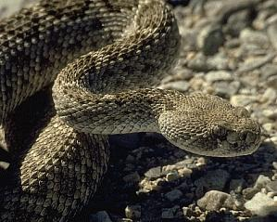

Stating the Problem
What invisible trail does a rattlesnake follow in tracking down its bitten prey?

Slide 5
Gathering Information
A rattlesnakes eyes are only sensitive to visible light
A pair of organs located under the eyes detect invisible light in the form of heat
A rattler’s tongue “smells” certain odors in the air
The sight or smell of an unbitten animal does not trigger the rattler’s tracking action

Slide 6
Hypothesis
After the snake wounds its victim, the snake follows the smell of its own venom to locate the animal

Slide 7

Experiment
Drag a dead mouse that has been struck and poisoned by a rattlesnake along a curved path on the bottom of an empty cage
Place the snake in the cage
The snake follows the exact trail that has been laid out
Control
Drag an unbitten dead mouse along the path
The snake seems disinterested

Slide 8
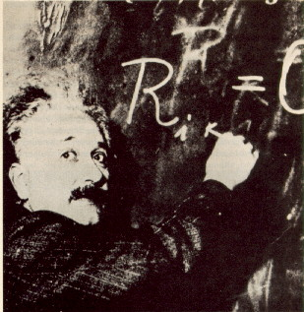
Recording and Analyzing Data
Do the experiment many times
Record the data

Slide 9
Conclusion
The scent of venom was the only factor that could cause a rattlesnake to follow its bitten victim.

