Slide 1
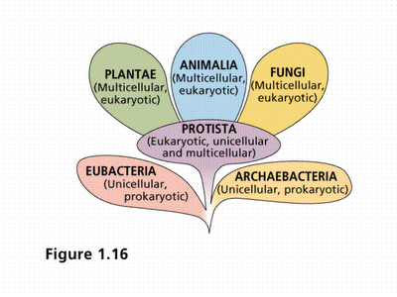
Chapter 9
Classification

Slide 2
Terms to Learn
Classification
Kingdom
Phylum
Class
Order
Family
Genus
Species
Taxonomy
Dichotomous Key

Slide 3
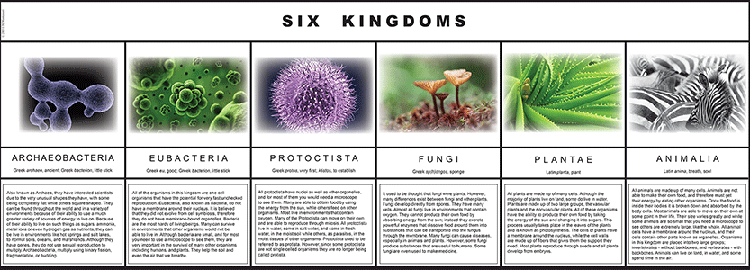
Classification
Classification is the arrangement of organisms into orderly groups based on their similarities
We classify so that scientists can answer questions about species and their characterisitics

Slide 4
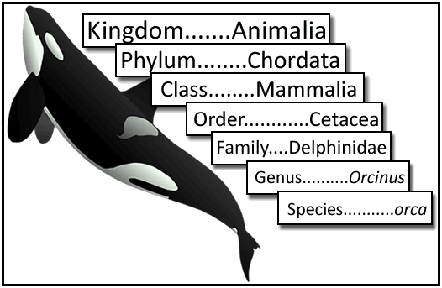
Levels of classification
Kingdom – largest most general group
Phylum – members of the same phylum are more like each other than another phylum
Class
Order
Family
Genus
Species

Slide 5
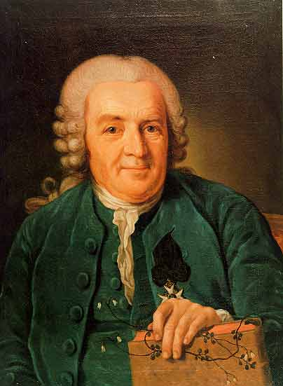
History of Classification
Carolus Linnaeus – Swedish physician and botanist who lived in the 1700’s
Founded taxonomy
Today we still classify based on presumed evolutionary relationships
Branching diagrams – another way to show evolutionary relationships between organisms

Slide 6
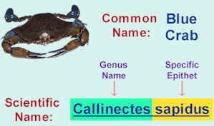
Scientific Names
Scientific names is always the same for a specific organism no matter how many common names it has
First part is the genus and the second name is the species
Elephas maximus – Indian Elephant first word is always capitalized and the second word is lowercase. Always italicized or underlined
Scientific names are in Latin or Greek

Slide 7
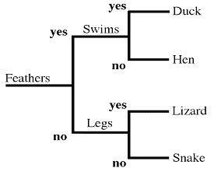
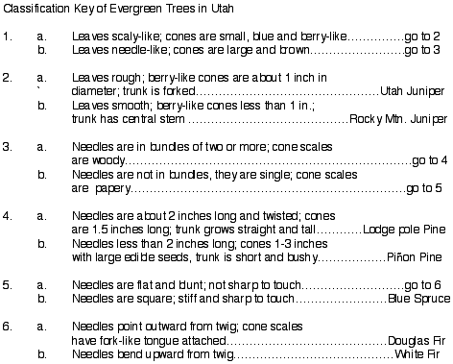
Dichotomous Key
Dichotomous key consists of several pairs of descriptive statements that have only two alternative responses
You must answer the questions to identify the organism

Slide 8
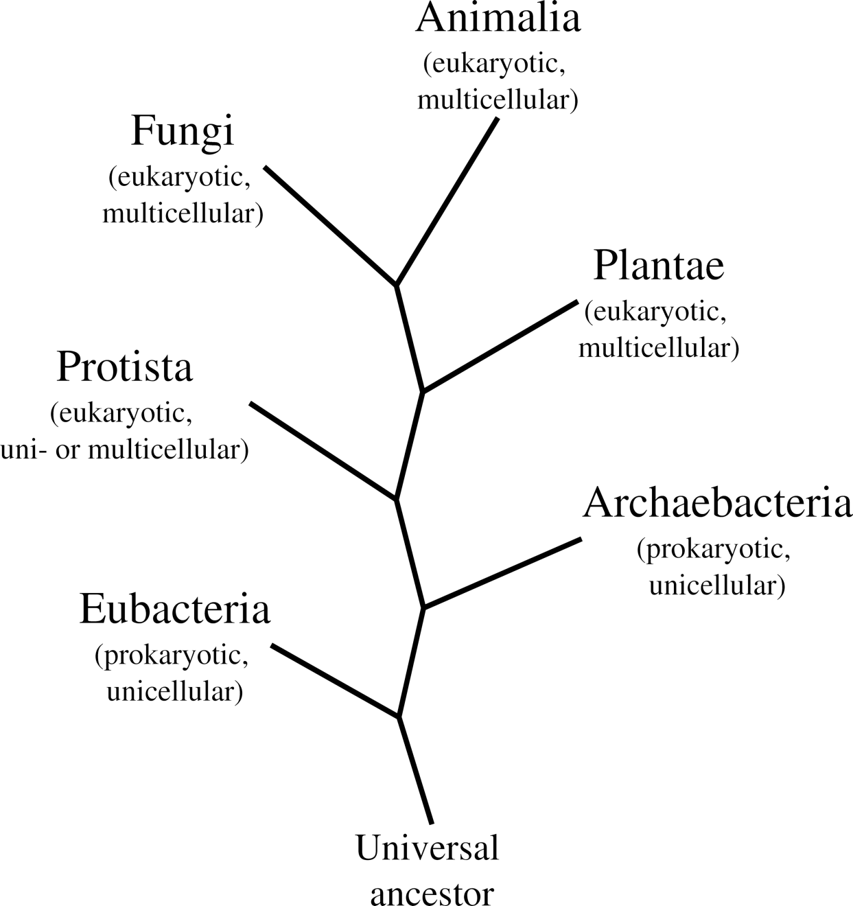
Section 2 - The Six Kingdoms
Terms to learn
Archaebacteria
Eubacteria
Protista
Plantae
Fungi
Animalia

Slide 9
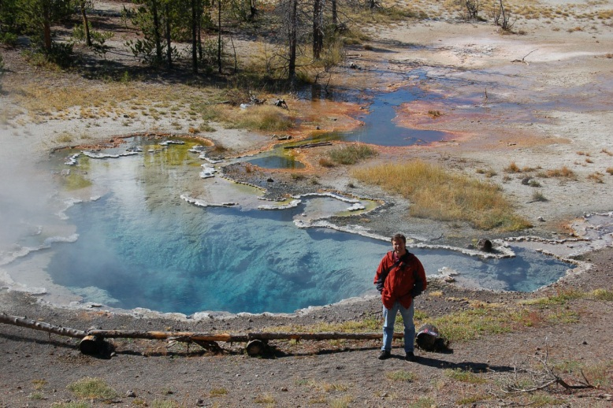
Two Kingdoms of Bacteria
Bacteria are extremely small single –celled organisms that are prokaryotic ( no nuclei)
Divided into Archaebacteria and Eubacteria
Archaebacteria – have been on the planet at least 3 billion years old and lives in places where nothing else can survive
Eubacteria – Most of all the other bacteria

Slide 10
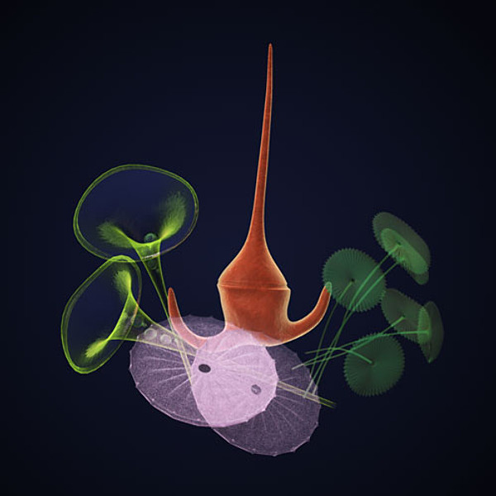
Protista
Called Protists and are single celled or simple multicellular organisms
Unlike bacteria protists are eukaryotic (have a nucleus and membrane bound organelles
Contains all the eukaryotes that are not plants, animals, or fungi.
Scientists think that the first protists evolved from ancient bacteria

Slide 11
Plantae
Plants are complex multicellular organisms that are usually green and use the sun’s energy to make sugar by a process called photosynthesis.

Slide 12
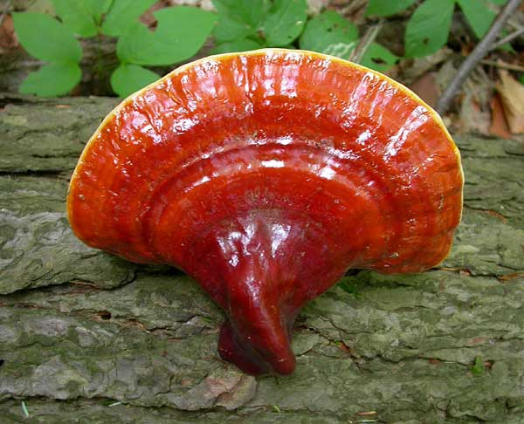
Fungi
Complex multicellular organisms that were originally classified as plants but fungi do not use photosynthesis but they do not have animal characteristics and therefore have a separate kingdom
Instead of using photosynthesis or eating their food fungi absorb their food after breaking them down with digestive juices

Slide 13
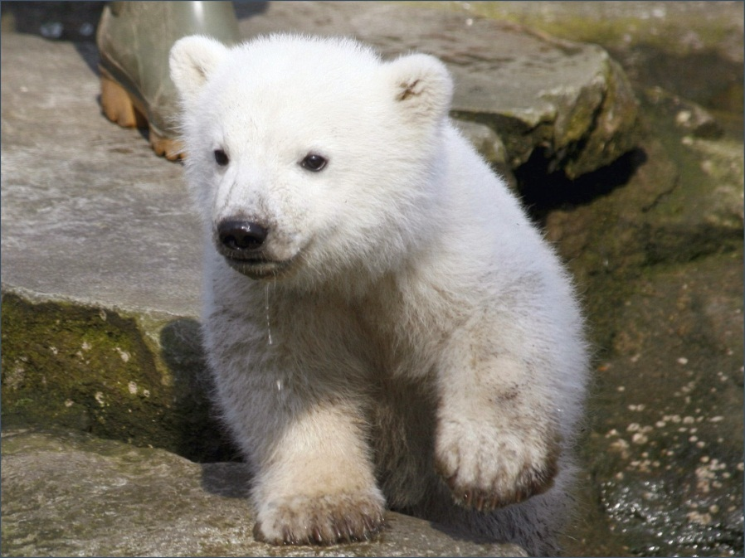
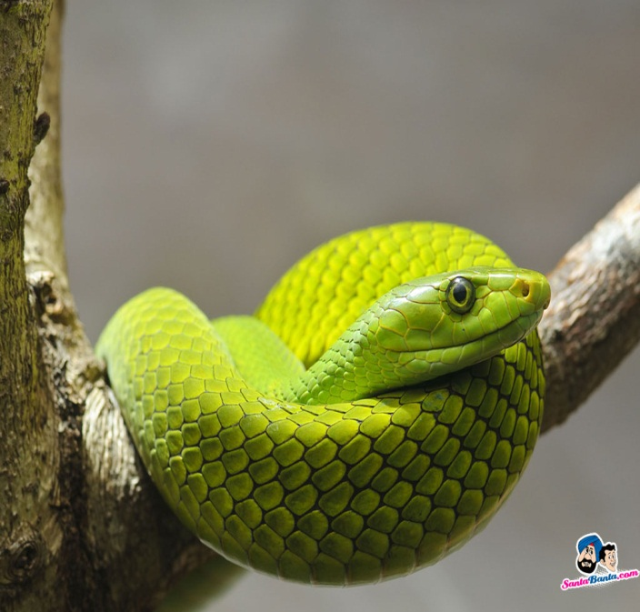
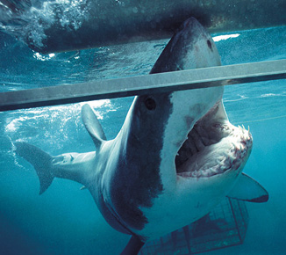
Kingdom Animalia
Complex multicellular organisms that have a nervous system: the cell also lacks a cell wall.

