Slide 1
Chapter 22
The Nature of Light

Slide 2
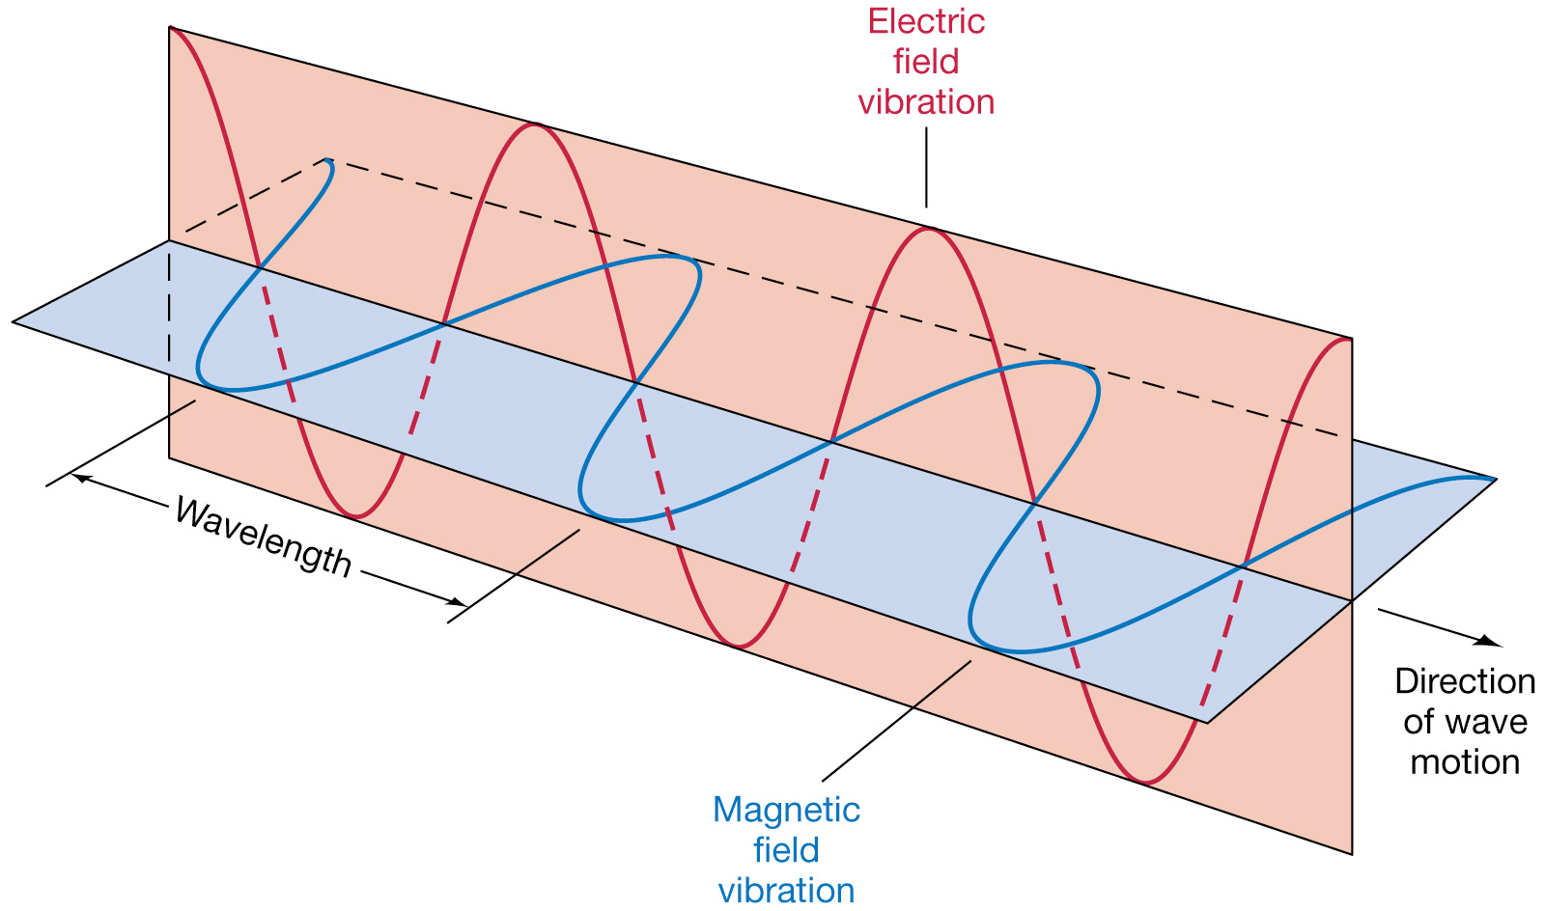
Section 1 – What is Light
Terms to Learn
Electromagnetic Wave
Radiation

Slide 3
Light is an electromagnetic wave
Light is a type of energy that travels as a wave
Unlike sound light does not need a medium through which to travel.
Light is an electromagnetic wave that can travel through space or matter and consists of changing electric and magnetic fields
A field is a region around an object that can exert a force, a push, or pull, on another object without actually touching the object.

Slide 4
How is Light produced?
An EM wave is produced by the vibration of an electrically charged particle.
A particle with an electric charge is surrounded by an electric field. When the particle vibrates the electric field around it vibrates too. When the field vibrates a vibrating magnetic field is created. This produces the EM wave that carries energy released by the original vibration
This emission of energy in the form of EM waves is called radiation.

Slide 5
Light bulbs
Electrical energy supplied to the filament in the light bulb makes the atoms vibrate. Which makes the particles in the atom begin to vibrate. This produces light

Slide 6
The speed of light
Scientists have yet to discover anything that is faster than the speed of light
In the vacuum of space it travels about 300,000,000 m/s
Light travels about 880,000 times faster than sound
That is way you see the lightning then hear the thunder

Slide 7
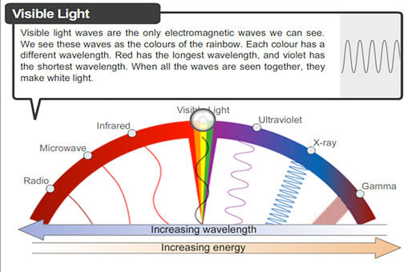
Section 2 – The electromagnetic spectrum
Terms to Learn
Electromagnetic spectrum

Slide 8
Light
You see objects because light reflects off them
There are many types of EM waves but they all travel the same speed in space
300,000,000
The entire range of EM waves are called the electromagnetic spectrum

Slide 9
Radio waves
Radio waves cover a wide range of the waves in the EM spectrum.
Can have some of the longest wavelengths and the lowest frequencies. Therefore radio waves are low energy waves but are strong enough to carry radio signals
Two types of radio waves which have different modulations
AM – amplitude modulation
FM – frequency modulations which can carry more information and therefore are used by stations that carry mostly music

Slide 10
TV and radio waves
TV signals are also carried by radio waves. They use AM waves to carry pictures and FM waves to carry sound

Slide 11
Microwaves
Microwaves have shorted wavelengths and higher frequencies which means they carry more energy.

Slide 12
Radar
Also use microwaves in RADAR (radio detection and ranging) which detects the speed and location of objects. The police officer shoots a beam onto a moving car and depending on how fast the beam returns tells you how fast the car is moving.

Slide 13
Infrared waves
Infrared waves have shorter wavelengths and higher frequencies than microwaves which means that they can carry more energy than microwaves and radio waves.
You feel warm because infrared rays from the sun are absorbed on your skin which makes the atoms in your skin vibrate faster which is what you feel as warmth.
You can use infrared binoculars to see objects giving off heat. Warmer objects give off more infrared waves

Slide 14
Visible light
Visible light is the very narrow range of wavelengths and frequencies in the electromagnetic spectrum that humans can see. Humans see different wavelengths as different colors
The longest wavelengths are seen as red and the shortest wavelengths are seen as violet light and because violet has the shortest wavelengths it carries the most energy

Slide 15
Colors of Light
The colors you see are called visible light in the visible spectrum
ROY G BIV
Red Orange Yellow Green Blue Indigo Violet
When all the colors are combined you see it as white light such as incandescent and fluorescent light bulbs

Slide 16
Ultraviolet light
Ultraviolet light is another type of EM wave produced by the sun. It has higher frequencies and shorter wavelengths than visible light so it carries more energy
This helps us and hurts us
We produce artificial UV light to kill bacteria on food and vertical instruments. Limited exposure to the sun gives us Vitamin D which helps us to absorb calcium by our intestines
Hurts us by causing sunburn, skin cancer, damage to the eyes, wrinkles, and premature aging of the skin

Slide 17
X rays and gamma rays
Have some of the shortest wavelengths and highest frequencies of all the EM waves. X rays carry a lot of energy and can penetrate a variety of materials. Useful in the medical field but too much exposure can harm the cells.
Gamma rays – carry large amounts of energy and can penetrate materials very easily
You are exposed everyday but they do not harm you some are used to treat cancer when radiologists focus the gamma rays on the tumor to kill the cancer cells. Some healthy cells are killed as well.

Slide 18
Section 3 – interactions of light waves
Terms to Learn
Reflection
Law of reflection
Absorption
Scattering
Refraction
Diffraction
Interference

Slide 19
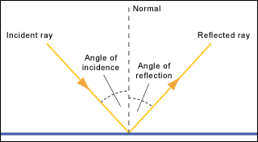
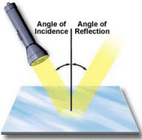
Reflection
Reflection occurs when light or any other wave bounces off an object. Cat’s eyes have a layer of cells that reflect light to give them better vision at night. Reflection is the only way you see objects
Law of reflection – states that the angle of incidence is equal to the angle of reflection which works like a ball you bounce on the ground

Slide 20
Types of reflection
Why can you see your reflection in a mirror but not a wall
Mirror have a smooth surface and the light bounces off at the same angle called regular reflection whereas a wall is not smooth enough and light bounces off in all directions (diffuse reflection)

Slide 21
Absorption of light
In a flashlight beam objects closer are brighter than those further away this is because of absorption and scattering
Absorption is the transfer of energy carried by light waves to particles of matter. When you shine a flashlight the air particles absorb some of the energy. This causes the light to become dim. The further the light travels the dimmer it becomes

Slide 22
Scattering of light
Scattering – the release of light energy by particles of matter that has absorbed energy
Light is scattered in all directions by air particles
This makes the sky blue because blue has the shortest wavelength and is scattered more than the other particles. So when you look at the sky you see a background of blue

Slide 23
Refraction
Refraction – is the bending of a wave as it passes at an angle from one medium to another
Speed of the wave changes as the wave passes through different mediums. When they change speed the wave bends in the direction which slowed down first
It has to enter at an angle for refraction to happen
Light waves with short wavelengths bend more than waves with long wavelengths

Slide 24
Diffraction
Diffraction is the bending of waves around barriers or through openings
Diffraction occurs best when the opening or barrier is smaller or the same size as the wavelength
That is why light does not travel around corners. The wavelength of light 100 times smaller than a human hair.
Light will diffract a little which is why the edges of your shadow look blurry.

Slide 25
Interference
Interference is a wave interaction that occurs when two or more waves overlap.
Overlapping waves can combine by constructive or destructive interference
Constructive interference is when waves combine and the amplitude of the resulting wave is larger. If this was light then the resulting light would be brighter
Destructive interference is when waves combine and the resulting wave has a smaller amplitude. In light the resulting light would be dimmer.
Rarely do the wavelengths combine to result in total destructive interference

Slide 26
Section 4 – Light and Color
Terms to Learn
-Transmission
-Transparent
-Translucent
-Opaque
-Pigment

Slide 27
Light and matter
When light strikes an object it can interact in three different ways
Reflections – you can see glass and your reflection in it
Absorption – light is absorbed into glass which is why it feels warm when you touch it
Transmission – You can see objects outside because light is transmitted through the glass. Transmission is the passing of light through matter
All the light you see has been transmitted through the air.

Slide 28
Types of matter
Transparent – objects through which might can easily pass. You can see objects clearly.
Translucent – transmits light but also scatters the light as it passes through. Wax paper
Opaque – Matter that does not transmit any light. You cannot see through these objects.

Slide 29
color
The color an object appears to be depends on the wavelength of light that reaches your eyes.
Light reaches your eyes after being reflected off another object and is converted into electrical impulses and interpreted by your brain as colors
Remember that white is all the colors combined and black is the absence of color because all the colors are being absorbed.

Slide 30
Colors of clear or translucent objects
Glass is clear because it allows all the colors to pass through it. Green glass is green because all the colors are absorbed but green is transmitted through.

Slide 31
Mixing colors of light
Primary colors – red, blue, and green combine to make white light
You can add these together in different ratios to produce any color
Pigment – material that gives a substance its color by absorbing some colors of light and reflecting others. Mixing pigments gives you colors in art.

