Slide 1
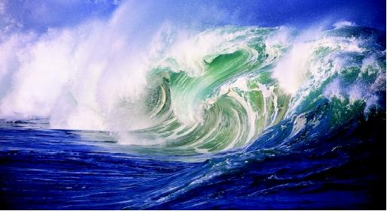
Chapter 20
The Energy of Waves

Slide 2
Section 1 – The nature of waves
Terms to Learn
Wave
Medium
Transverse wave
Longitudinal wave

Slide 3
Waves
Waves – any disturbance that transmits energy through matter or space.
Examples; water waves in the oceans, microwaves in the microwave, light waves from the sun, radio waves to the radio, and sound waves from the radio, telephone, and voices

Slide 5
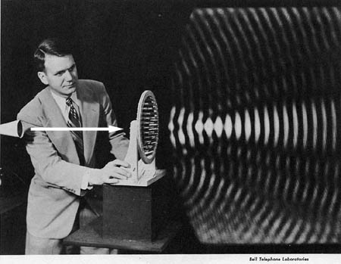
Waves
Waves carry energy – energy is carried in a wave but the material the wave travels through does not move with the wave
If the air moved every time a wave traveled through it you would feel a waft of air every time the phone rings.

Slide 6
Mediums
Mediums – substance through which a wave can travel; can be a solid, liquid, or a gas.
Sound waves require a medium
When a waves travels through a medium it vibrates a particle which vibrates the particle next to it and transfers energy. Since sound needs a medium there is no sound without particles so there would be no sound in a vacuum.
Other waves that require a medium include ocean waves through water and waves on string instruments

Slide 7
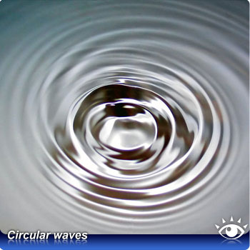
Mechanical waves
Waves that require a medium are called mechanical waves

Slide 8
Electromagnetic Waves
Electromagnetic waves – waves that do not require a medium
Visible light does not require a medium otherwise the suns rays would not reach us.
Microwaves, TV and radio signals and X rays
Electromagnetic waves can travel through air, water, and glass but travel faster through empty space

Slide 9
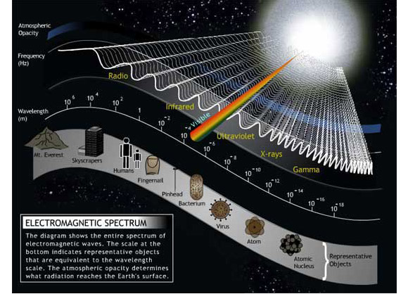

Slide 10
Types of Waves
Waves are classified based on the direction in which the particles of the medium vibrate compared with the direction in which the waves travel.
Two main types are transverse and longitudinal

Slide 11
Transverse waves
Transverse waves are where the waves travel in an up and down motion. Transverse means “moving across”, they move across or perpendicular to the direction that the wave is traveling.
Example: Wave moving on a rope
Highest point on a transverse wave is called a crest.
Lowest point between each crest is called a trough.
Although electromagnetic waves do not travel by vibrating particles in a medium, all electromagnetic waves are classified as transverse waves

Slide 12
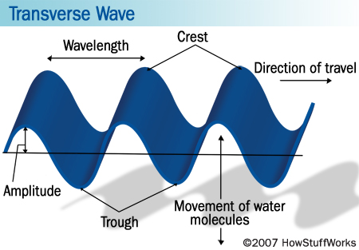

Slide 13
Longitudinal Waves
Longitudinal waves – the particles of the medium vibrate back and forth along the path that the wave travels
Example: Spring
A section of a longitudinal wave where the particles are crowded together is called a compression
A section where the particles are less crowded than normal is called a rarefaction
Sound wave is an example of a longitudinal wave

Slide 14
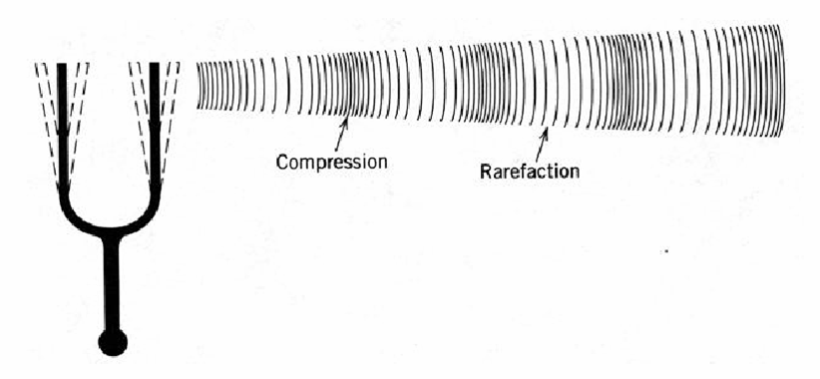

Slide 15
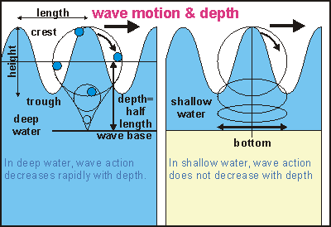
Surface Wave
When waves occur at or near the boundary between two media, a transverse wave and a longitudinal wave can combine to form a surface wave
Surface waves look like transverse waves but the particles of the medium in a surface wave move in circles rather than up and down

Slide 16
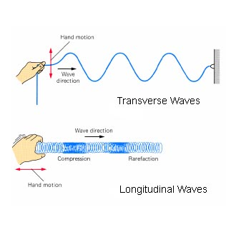
Section 2 – Properties of Waves
Terms to Learn
Amplitude
Wavelength
Frequency
Wave speed

Slide 17
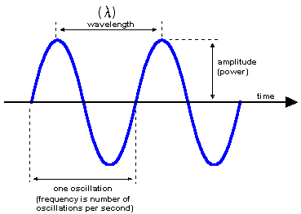
Amplitude
Amplitude-Maximum distance the wave vibrates from its rest position (the position the particles of a medium stay when there is no disturbance)
Height of a wave is amplitude
The larger the amplitude is, the taller the wave
A wave with a large amplitude carries more energy

Slide 18
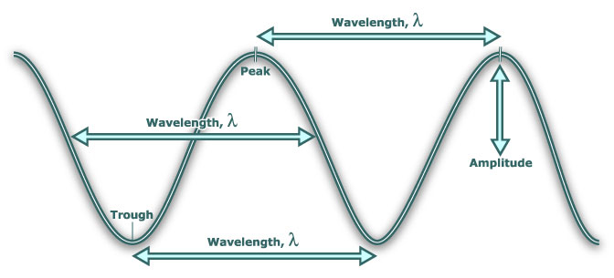
Wavelength
Wavelength – distance between any two adjacent crests or compression in a series of waves.
Can be measured from any one point on one wave to the same point on the next wave

Slide 19
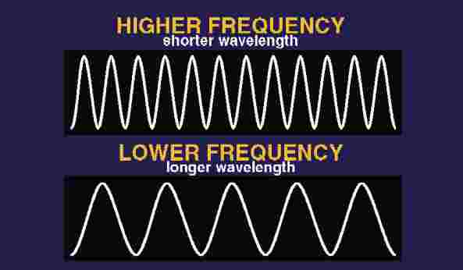
Frequency
Frequency – the number of waves produced in a given amount of time
Counting the number of crests or troughs that pass a point in a given amount of time
Usually expressed in Hertz (Hz) – For waves one hertz equals one wave per second
Related to wavelength in that the higher the frequency the shorter the wavelength
The higher the frequency the more energy it carries and the shorter the wavelength the more energy it carries

Slide 20
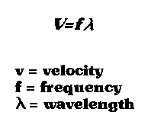
Wave Speed
Wave Speed – speed at which a wave travels; measured by how far a particular crest or trough travels in a given amount of time
Calculated by wavelength and frequency
Depends on the medium
Speed of sound through air is 340m/s
Speed of sound through metal is 5200m/s

Slide 21
Section 3 – Wave Interactions
Terms to Learn
Reflection
Refraction
Diffraction
Interference
Standing Wave
Resonance

Slide 22
Reflection
Reflection occurs when a wave bounces back after striking a barrier
All waves can be reflected including light, sound, and water
Reflected sound waves are called echoes and light reflected off the moon allows you to see it.

Slide 23
Refraction
Bending of a wave as it passes at an angle from one medium to another
When a wave enters a new medium at an angle the part that enters first changes speed and so the wave bends

Slide 24
Diffraction
Diffraction – the bending of a wave around a barrier or through an opening
The amount of diffraction a wave experiences depends on the wavelength and the size of the barrier or opening the wave encounters
Sound waves are larger and therefore can bend around corners, light waves are smaller and mostly travel in a straight line

Slide 25
Interference
Interference – The result of two or more overlapping waves. Matter has volume but waves are energy so more than one can be in the same spot at the same time.
Constructive interference increases Amplitude
When the crests of one wave overlap the crest of another wave. The resulting wave has a higher crest and deeper trough. The amplitude for the overlap is larger
Destructive Interference Decreases Amplitude
When the crest of one wave and the troughs of another wave overlap. The resulting wave has a smaller amplitude that the original. When two waves have the same amplitude and overlap they completely cancel on another.

Slide 26
Why does Aluminum Foil destroy your microwave?
Aluminum foil doesn't actually burn in the microwave. What you are seeing is called the "electro-magnetic effect." Microwaves travel as particles called photons, and when those photons hit your aluminum, they collide with the aluminum atoms and create extra electrons. Now, in larger pieces of metal, like a fork or a thermos, these electrons are distributed throughout the bulk of the object, but on thin pieces of conductive metals, like aluminum foil or gold plating, these electrons quickly build up a significant electric charge. What happens next is the same thing that happens when you drag your sock feet across the carpet in the winter and shock someone with the static charge. Sparks begin jumping from one part of the foil to another, or from the foil to the microwave itself. These sparks can cause a fire and ruin your microwave oven, to say nothing of your poor baked potato. Conventional ovens do not use microwaves, but rather just heat up the foil. Aluminum won't catch fire no matter how hot you get it, although it will eventually melt. But it is unlikely that your conventional oven will ever become that hot.

