Slide 1
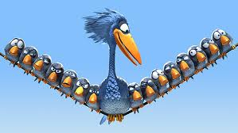
Chapter 17
Birds and Mammals

Slide 2
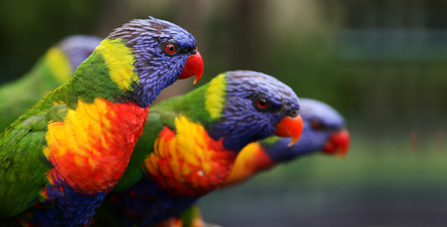
Section 1 – Birds
Vocabulary Terms
1. Down Feather –
2. Contour Feather –
3. Preening –
4. :Lift –
5. Brooding –

Slide 3
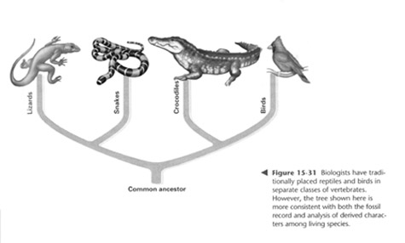
Bird Characteristics –
- Birds are thought to be descendants of reptiles and other vertebrates
- Like reptiles the skin around birds’ feet and beak is scaly and dry, have an amniotic egg (harder shell)
- Have feathers, beaks, and can fly

Slide 4
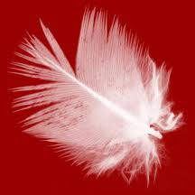
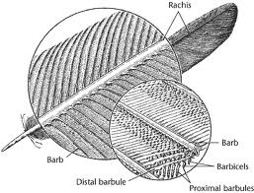
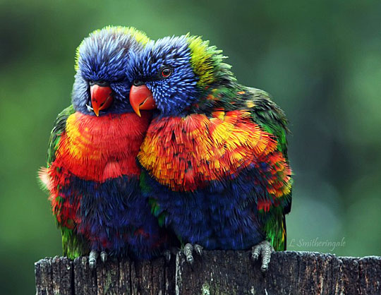
Feathers – Two types
- i. Down Feathers – fluffy insulating feathers next to the body which birds fluff up to form a layer of insulation
ii. Contour Feathers – have a center shaft with side branches called barbs which link together to be smooth.
iii. Birds preen their feathers with oil from a gland near their tail. The oil keeps the feathers watertight and clean

Slide 5
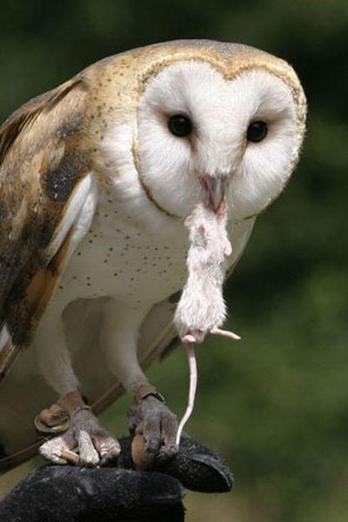
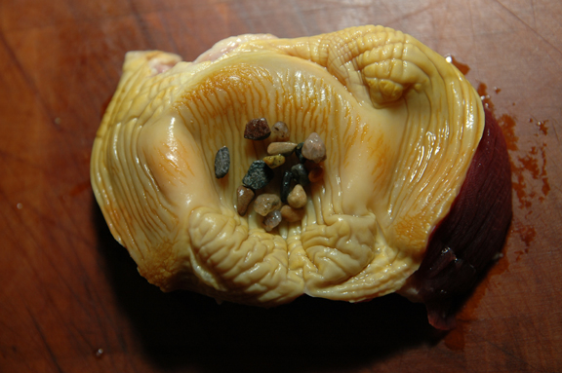
Eating
i. Birds have a high metabolism because they need a lot of energy to fly. They have a high body temp (103) and cannot sweat
ii. They eat a lot of food (high protein, fat, meat, seeds)
iii. Have no teeth so they grind food up in their gizzard which contains small stones. Food is stored in the crop and then sent through the digestive tract, which is small

Slide 6
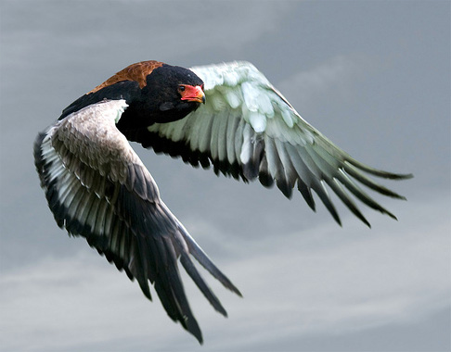
Flying – adaptations for flying and migrating
- i.Large eyes –
ii. Heart that beats rapidly – allows more blood flow
iii. Air sacs – birds can take in more oxygen for activity
iv. Wings – A bird’s wing is shaped to create lift. Air moving over the wing moves faster creating a difference in air pressure. The difference of above and below the wing keeps the bird in the air. The larger the wing the easier flight is.
v. Rigid Skeleton – some bones do not have joints and cannot move: this makes flying more efficient
vi. Lighter Skeleton – hollow bones
vii. Flight Muscles – attached to keel bone: powerful
viii. Keel Bone – large breastbone

Slide 7
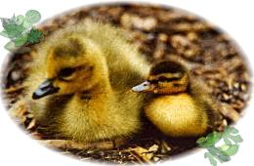
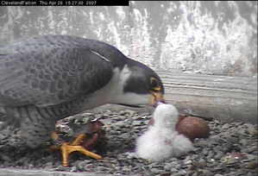
Parenthood
- i. Reproduce by internal; fertilization
ii. Lay amniotic eggs
iii. Types of chicks
1. Precocial – babies are ready to follow as soon as the can stand follow the first thing that moves – chickens, ducks, shorebirds
2. Altricial – born helpless, naked – need cared for by an adult – hawks, songbirds and most other birds

Slide 8
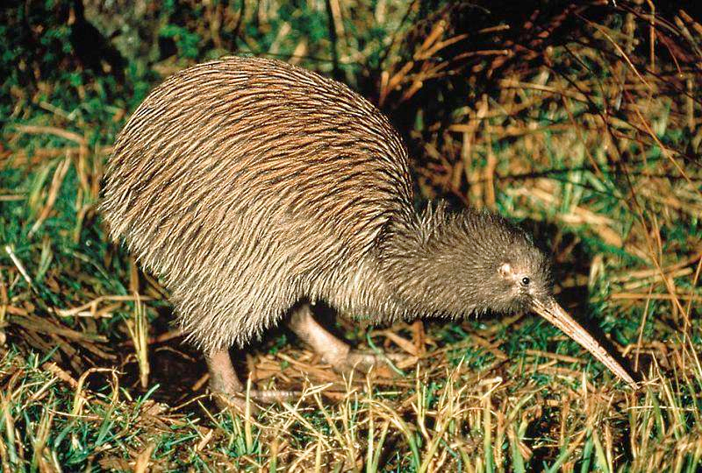
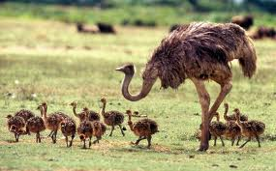
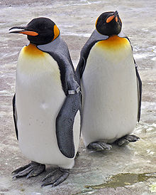
Types of Birds
- usually classified into four non scientific categories
- Flightless birds – penguin, ostrich, kiwi

Slide 9
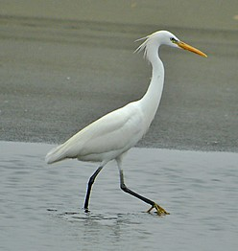
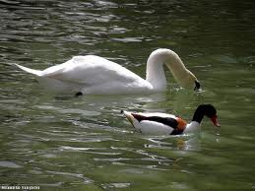
Types of Birds
Water Birds – ducks: have webbed feet for swimming: strong flyers

Slide 10
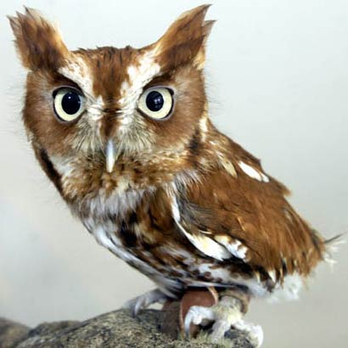
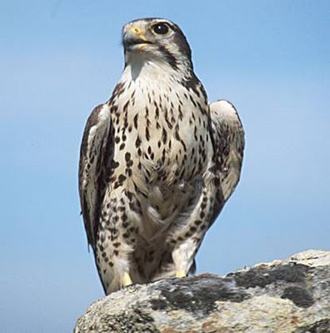
Types of Birds
Birds of prey – Eagles, hawks, falcons
i. Meat eaters, have claws

Slide 11
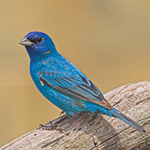
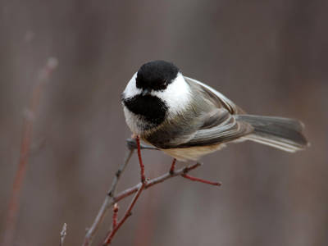
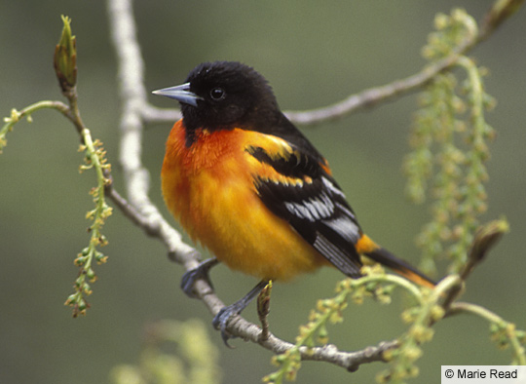
Types of birds
Perching Birds – have special feet which grab branches as it lands and holds on even if they fall asleep.

Slide 12
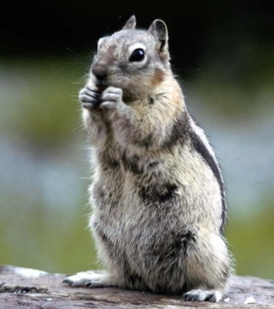
Section 2 – Mammals
Vocabulary terms
1. Mammary Glands –
2. Diaphragm –
3. Monotreme –
4. Marsupial –
5. Placental Mammal –
6. Gestation period –

Slide 13
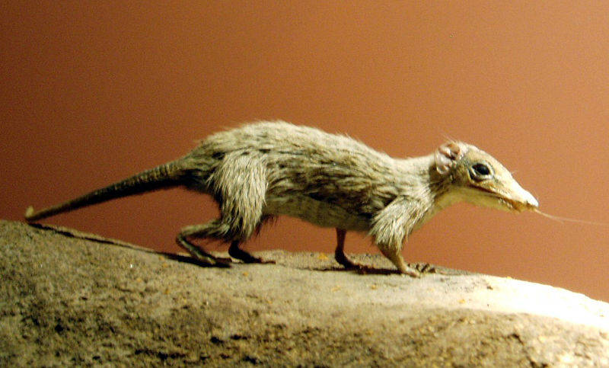
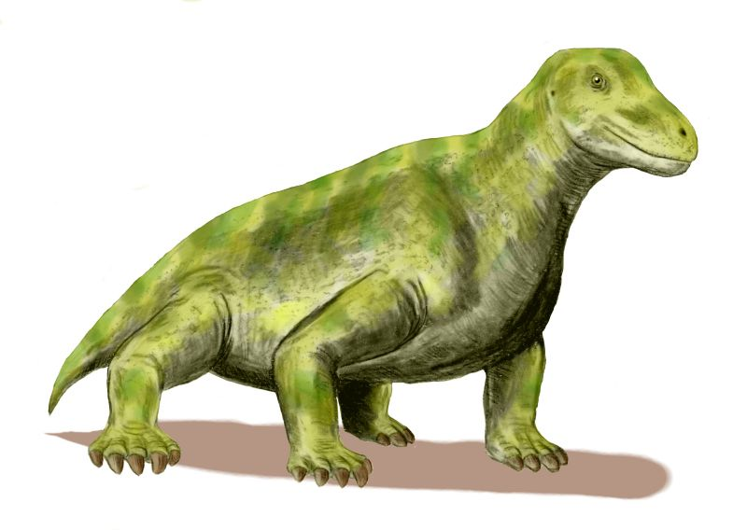
Therapsids
Origins of mammals – Mammals developed from therapsids
- Earliest mammals were the size of mice
- Endotherms

Slide 14
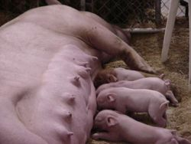
Characteristics of Mammals –
- Mammary Glands – all females supply milk for their young

Slide 15
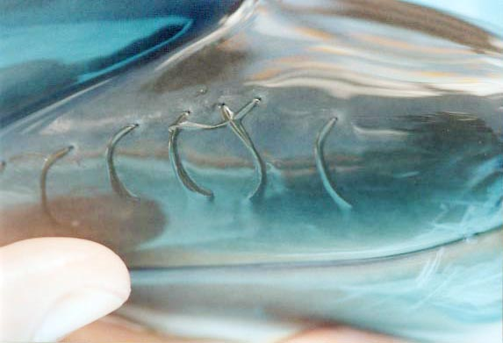
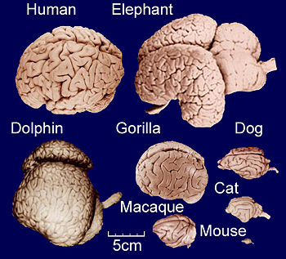
Mammal Characteristics
Endotherms – warm blooded
-Hair – all mammals have hair on their body somewhere at some time
-Teeth – two sets upper and lower
-Lungs - used to get oxygen from the air
-Diaphragm – muscle to bring air into the lungs: sits at the bottom of the rib cage
-Large Brains – larger than other animals of the same size
-Reproduce sexually

Slide 16
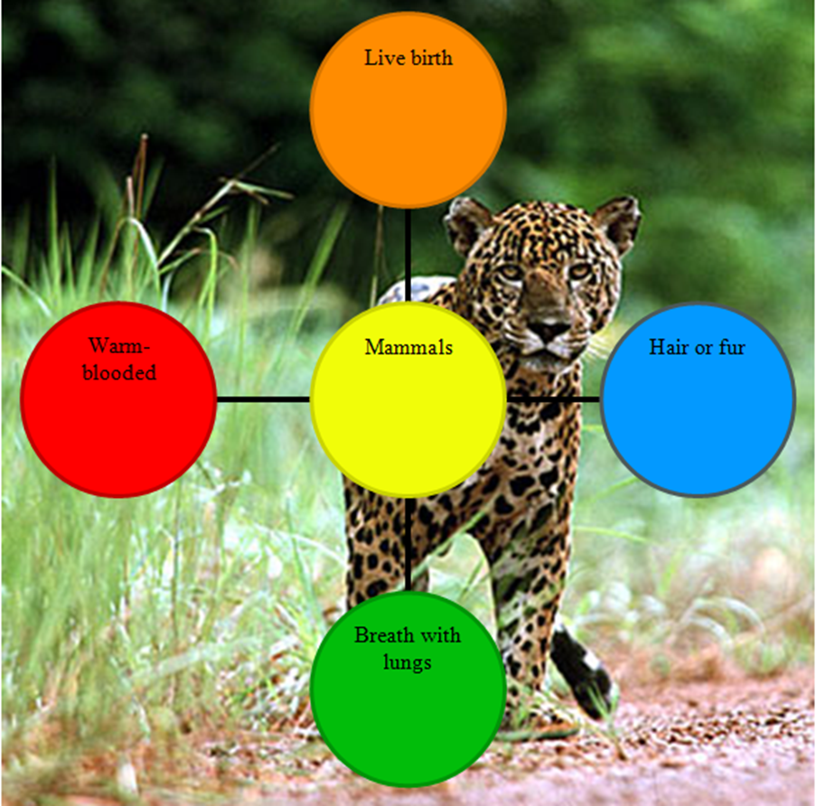

Slide 17
