Slide 1
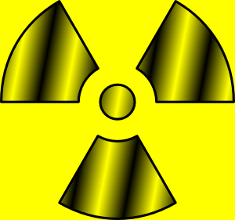
Chapter 16 – Atomic Energy

Slide 2
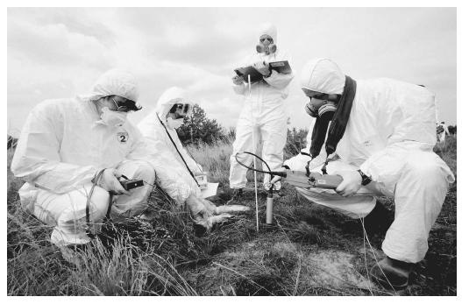
Section 1 Radioactivity
Terms to Learn
Nuclear radiation
Radioactivity
Radioactive Decay
Alpha Decay
Mass Number
Beta Decay
Isotopes
Gamma Decay
Half Life

Slide 3
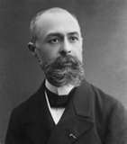
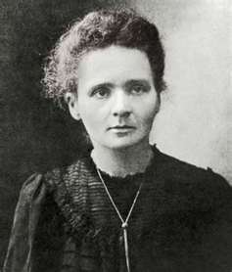
Discovering Radioactivity
Becquerel discovered radiation in 1896 – he was originally testing for UV light to leave an image on a photo plate but even without the light the rock was given off energy.
He figured this was due to the plutonium in the rock
This is nuclear radiation – high energy particles and rays that are emitted by the nuclei of some atoms
Radioactivity is the ability to give off nuclear energy (Marie Curie)

Slide 4
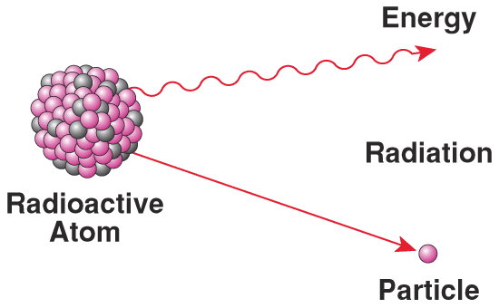
Nuclear radiation is produced through Decay
Radioactive decay is the process in which the nucleus of a radioactive atom releases nuclear radiation
Three types of radioactive decay are
Alpha decay
Beta decay
Gamma decay

Slide 5
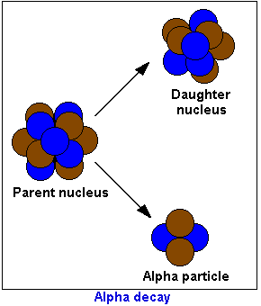
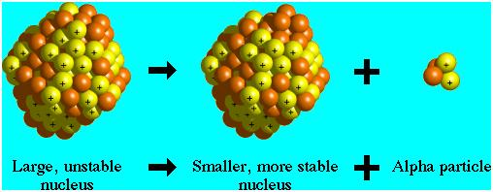
Alpha Decay
Alpha Decay – the release of an alpha particle from a nucleus
Alpha particle consists of two protons and two neutrons
This means it has a mass number of 4 and a charge of 2+
Remember mass number is the sum of the protons and the neutrons in an atom
All decay shares two characteristics
The mass number is conserved- the mass number of the reactants equals the mass number of the products
The charge is conserved – The sum of the charges of the reactants equals the sum of the charges of the products

Slide 6
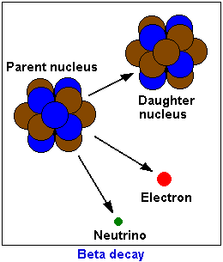
Beta Decay
Beta decay is the release of a beta particle
Can be either an electron (having a charge of 1- and a mass of almost 0) or a positron (having a charge of 1+ and a mass of almost 0)
Because electrons and positrons do not contain protons or neutrons the mass number of a beta particle is 0

Slide 7
Two types of Beta Decay
Carbon -14 nucleus undergoes beta decay. During decay a neutron breaks into a proton and an electron. Nucleus becomes a nucleus of a different element. Mass number and charge are conserved.
Isotopes are atoms that have the same number of protons but different numbers of neutrons.

Slide 8
Example
A carbon -11 nucleus undergoes beta decay when a proton breaks into a positron and a neutron. However, the beta decay of carbon-11 still changes the nucleus into a nucleus of a different element while conserving both mass number and charge.

Slide 9
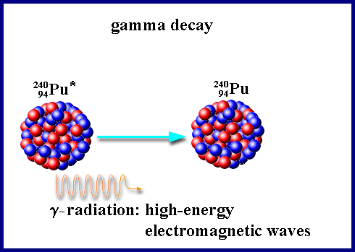
Gamma Decay
Energy is released during alpha decay and beta decay. Some of this energy is in the form of gamma rays, a form of light with very high energy.
Gamma decay is the release of gamma rays from a nucleus
Gamma decay occurs after alpha and beta decay as the particles in the nucleus shift to a more stable arrangement
Because gamma rays have no mass or charge, gamma decay alone does not cause one element to change into another as do alpha decay and beta decay

Slide 10
Power of radiation
There are three forms of nuclear radiation that differ in their ability to penetrate (go through) matter
Alpha particles have the greatest charge and mass. They travel about 7cm through air and are stopped by paper or clothing.
Beta particles have a 1- or 1+ charge and almost no mass. That are more penetrating than alpha particles. They travel about 1 m through the air, but are stopped by 3mm of aluminum.
Gamma rays have no charge or mass and are the most penetrating. They are blocked by very dense, thick materials, such as a few centimeters of lead or a few meters of concrete.

Slide 11
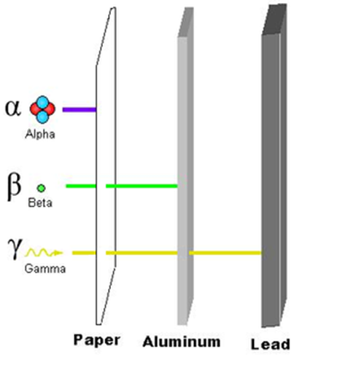

Slide 12
Effects of radiation on matter
Radiation can break chemical bonds between atoms. It can also knock electrons out of atoms. Both can cause damage living and non living things.
Cells can be damaged by radiation. Causes burns, can cause radiation sickness, and cancer.
Nonliving things can be hurt, metal can be weakened, space vehicles

Slide 13
Damage at different depths
Gamma rays are the most penetrating and cause damage deep within while beta rays cause damage slightly more shallow. Alpha rays are the most shallow but because they are the largest and most massive radiation they cause the most damage.

Slide 14
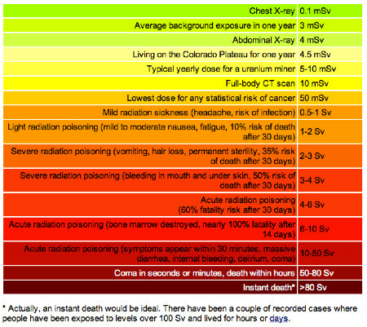

Slide 15
Nuclei decay to become stable
All nuclei composed of more than 83 protons are radioactive, this is because the force of attraction that holds a nucleus together is strong but only for a short distance. They may exist for billions of years but eventually decay and are therefore unstable. Too many protons

Slide 16
Ratio of neutrons to protons can also make a nuclei unstable.
If it contains too many or too few neutrons compared to protons

Slide 17
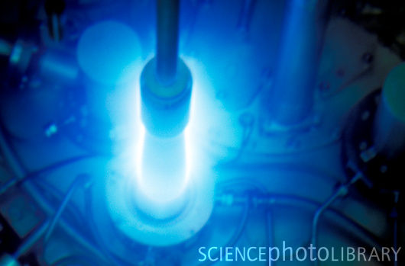
How does a nuclei become stable
An unstable nuclei will give off (emit) nuclear radiation until it has a stable number of protons and neutrons
Sometimes it takes more than one decay to become stable

Slide 18
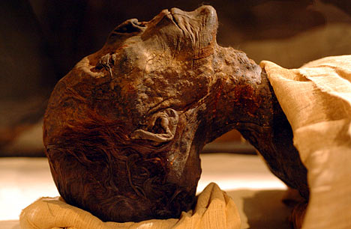
Finding a date by decay
Carbon-14 – Carbon atoms are found in all living things. A small percentage of these are carbon 14 radioactive atoms. During life the atoms are replaced but when you die they atoms are no longer replaced and they slowly decay.

Slide 19
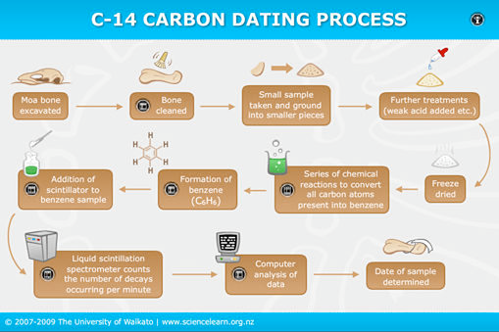

Slide 20
Decays Occur at a steady rate
Every 5,730 years half of the carbon 14 in a sample decays. The rate of decay is constant and is not affected by other conditions
Each radioactive isotope has its own rate of decay called a half life
Half life is the amount of time it takes for one half of the nuclei of a radioactive isotope to decay

Slide 21
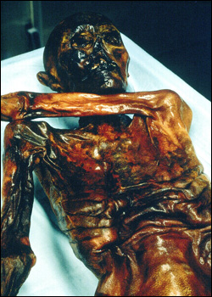
Determining age
The iceman’s age was determined by measuring the number of decays each minute.
Carbon 14 can be used to date things up to 50,000 years old
Anything past that you would need to use another element like potassium 40 which has a half life of 1.3 billion years

Slide 22
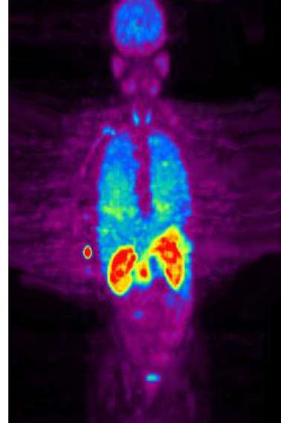
Radioactivity and your world
Tracers- can be used to follow elements through paths
Used by doctors to find and kill cancer cells
Used to power space probes
Farmers can use it to trace what elements plants take in

Slide 23
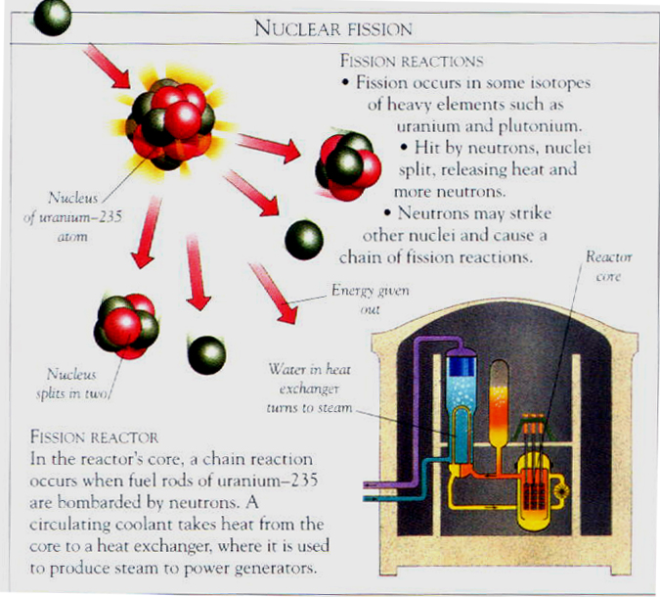
Section 2 – Energy from the Nucleus
Terms to Learn
Nuclear fission
Nuclear chain reaction
Nuclear fusion

Slide 24
Nuclear Fission
Not all unstable nuclei decay by releasing an alpha or beta particle or gamma rays. Some decay by breaking down into two smaller, more stable nuclei during nuclear fission.
Nuclear fission is the process in which a large nucleus splits into two smaller nuclei with the release of energy.

Slide 25
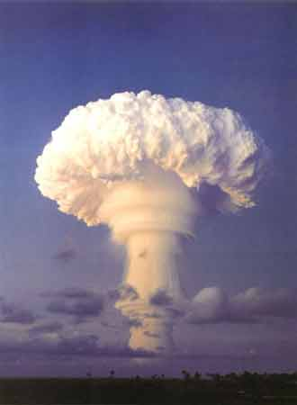
Energy from matter
You can get matter from energy. It is a tiny amount but the amount of material is tiny as well.
Nuclear chain reactions – a continuous series of nuclear fission reactions
Energy from a chain reaction – an uncontrolled chain reaction can produce a huge amount of energy such as an atomic bomb.

Slide 26
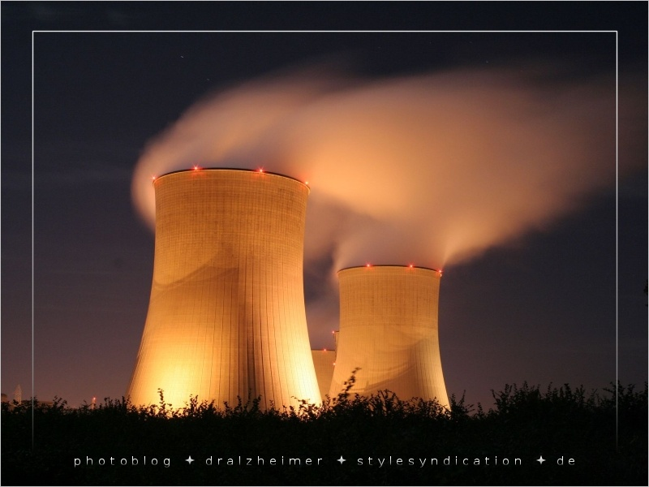
Nuclear versus fossil fuel
Nuclear power plants are more expensive to build than fossil fuel plants but they are less expensive to operate because less fuel is needed

Slide 27
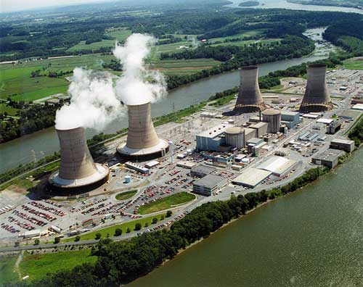
Nuclear power plants
Nuclear power also does not release gases such as carbon dioxide however uranium is also a limited resource.
Nuclear power plants supply about 20 percent of the U.S. power

Slide 28
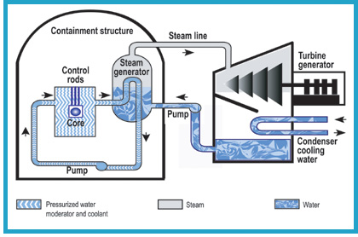

Slide 29
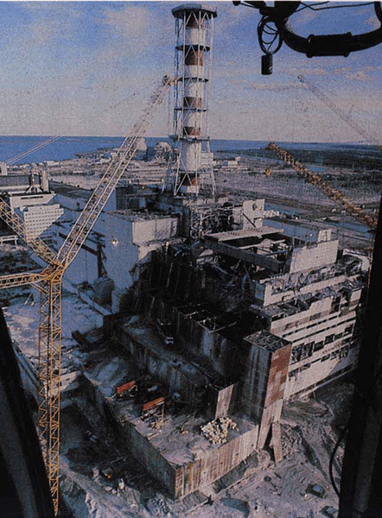
Problems with Nuclear energy
Chernobyl – April 26, 1986 – Explosion reached almost all of Europe, Asia and even reached the US.
Nuclear waste – All the spent rods, covers the workers wear and even the chemicals will emit radiation for thousands of years.

Slide 30
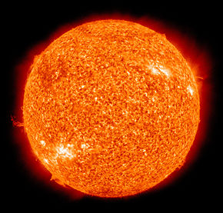
Nuclear Fusion
Another reaction where matter is converted to energy is nuclear fusion
Nuclear fusion is where two or more nuclei with small masses are joined together, or fuse, to form larger more massive nucleus.
The sun is the best source of nuclear fusion where hydrogen fuse together to form helium.

Slide 31
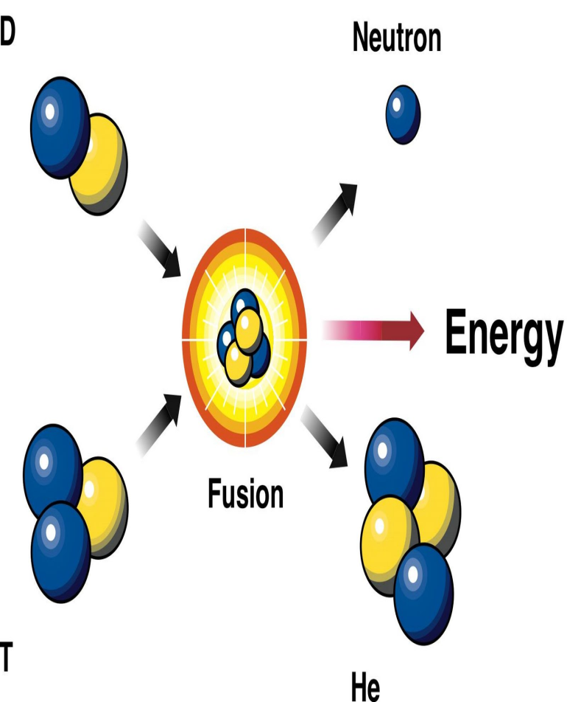
Nuclear fusion
We cannot contain hydrogen plasma and it requires as more energy to contain plasma than energy that fusion would create.
The fuel for fusion is pretty much unlimited as there is lots of hydrogen in the ocean
Less concern over an accident because even with an explosion little radioactivity would be released. There is also much less waste.

