Slide 1
Chapter 11
The Atom

Slide 2
Section 1 – Development of the Atomic Theory
Terms to Learn
Atom
Theory
Electrons
Model
Nucleus
Electron Clouds

Slide 3
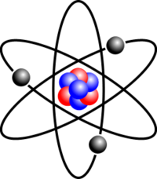
Atoms
Atoms are the smallest particle in to which an element can be divided and still be the same substance
Atoms make up elements which make up compounds
All matter is made up of elements and compounds therefore atoms are the basic building blocks of matter

Slide 4
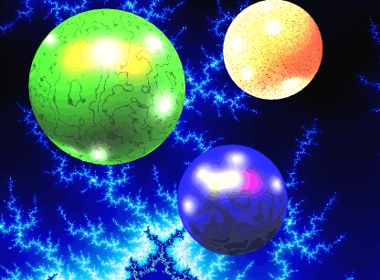
Theory is a unifying explanation for a broad range of hypotheses and observations that have been supported by testing

Slide 5
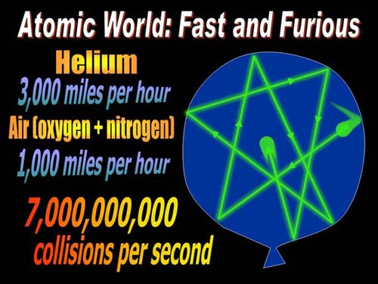
The history of the Atom
Democritus first proposed the atom (Greek for “indivisible”) in 440 B.C.
Also proposed that the are constantly moving and they combine to form other materials
Aristotle thought otherwise and since he was more popular he was thought correct

Slide 6
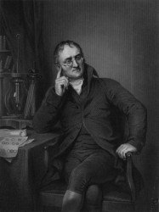
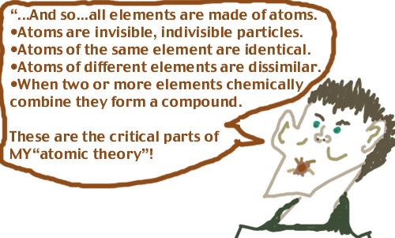
Dalton figured out that elements combine in specific proportions to form compounds based on mass because they are made of individual atoms
Dalton came up with the Atomic Theory

Slide 7
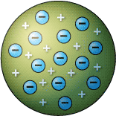
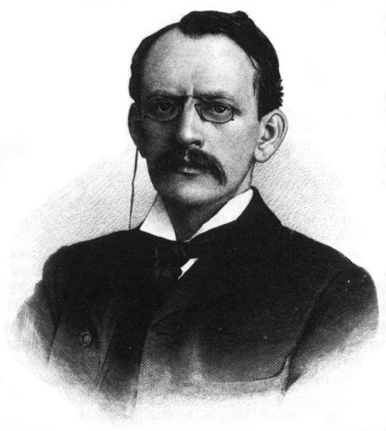
Thomson – 1897 he figured out that atoms are made of even smaller particles
He found that electrons (negatively charged particles) are present in every type of atom and that they are all identical
He knew that atoms have no overall charge so positive charges must be present to balance the negative charges
He built a model (a representation of an object or system) to show an atom called the plum pudding model

Slide 8
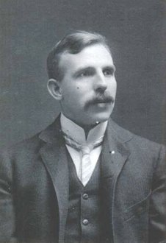
Rutherford performed the “gold foil” experiment in 1909. He shot positively charged rays through gold foil but not all went straight as expected some deflected and some bounced back
This meant something hard has to be inside the atoms, this lead to a nucleus theory.
Rutherford figured that a small, dense, positively charged center of the atom was present ( nucleus) so when he fired the positively charged particles at the gold those that hit the nucleus head on were bounced back at those that passed close by a nucleus were deflected by the positive charge because the nucleus is positively charged as well.
From this he calculated that the nucleus was 100,000 smaller than the diameter of the gold atom.

Slide 9
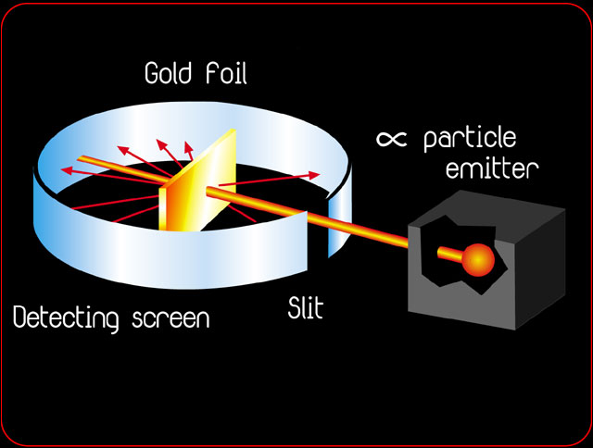

Slide 10
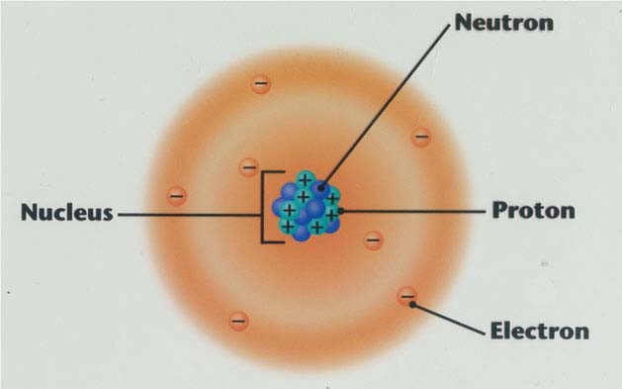
Bohr – stated that electrons travel around the nucleus in definite paths, they can jump from one path to another but cannot travel in between the paths
New research has proven that electrons do not travel in definite paths and we cannot predict the paths of the electrons
Electron clouds – regions where electrons are likely to be found

Slide 11
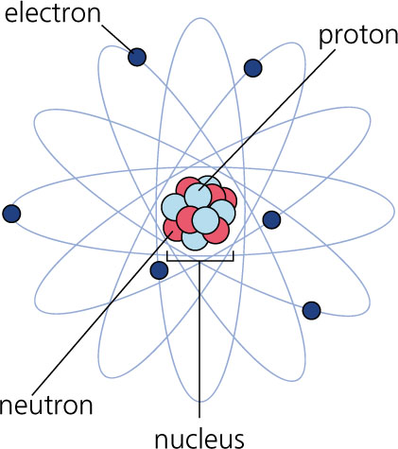
Section 2 – The Atom
Terms to Learn
Protons
Atomic Mass Unit
Neutrons
Atomic Number
Isotopes
Mass Number
Atomic Mass

Slide 12
What’s in an atom?
They are 0.00000003cm wide. That is three hundred millionths of a centimeter. It would take 50,000 aluminum atoms to equal the thickness of a sheet of aluminum foil
Atom are neutral (no overall charge) equal numbers of protons and electrons
If the numbers of protons and electrons are not equal then it becomes an ion which has a charge
If protons outnumber electrons then the particle becomes positively charged
If electrons outnumber protons then the particle becomes negatively charged

Slide 13
What’s in an Atom?
Nucleus – consists of protons and neutrons: it is VERY dense
Protons – positively charged particles of the nucleus
They are so small they have their own unit
Atomic mass unit – the SI unit used to express the masses of particles in atoms. Each proton has a mass of 1 amu
Neutrons – particles of the nucleus that have no charge. Also have a mass of 1 amu
Both neutrons and protons are identical

Slide 14
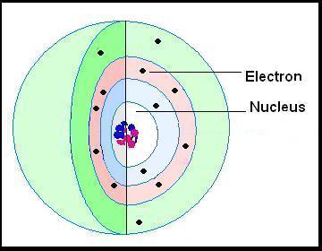
What’s in an Atom?
Electrons – outside the nucleus
Negatively charged particles in atoms
Likely to be found outside the nucleus in the electron clouds
So small the mass is considered to be zero

Slide 15
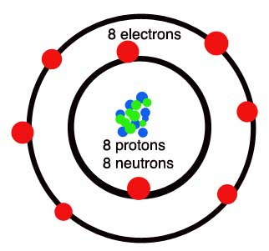
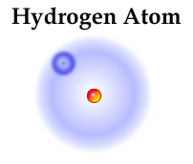
What makes elements different?
Elements are different
There are 100 different elements, each is made of different atoms made of different number so protons, electrons, and neutrons
A hydrogen atom has just one proton and one electron it does not even have a neutron.

Slide 16
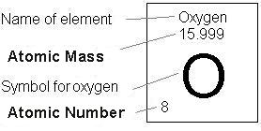
Atomic Number: Every type of atom has a unique number of protons in it. The number of protons in an atom is called the atomic number. Oxygen has an atomic number of 8 and thus, any atom with 8 protons is an oxygen atom. Carbon has an atomic number of 6, thus any atom with 6 protons is a carbon atom. Atoms are arranged on the periodic table in order of atomic numbers.

Slide 17
Mass Number: The mass number for an atom is equal to the number of protons plus the number of neutrons. Every proton and every neutron has an atomic mass of 1 a.m.u. (atomic mass units). Electrons have no mass. The average oxygen atom has 6 protons and 6 neutrons, 6+6=12, thus, oxygen has an atomic mass of 12 a.m.u. The average mass number for each atom is written on the periodic table of elements. To calculate the number of neutrons in an atom you use the formula:
Mass Number - Atomic Number = Number of Neutrons

Slide 18
Ions: Atoms with a positive or negative charge due to gaining or losing electrons.
If the number of protons does not equal the number of electrons, it is not an atom. It is an ion. Electrons rub off easily. Metals tend to lose electrons and nonmetals tend to gain electrons. Electrons laying around at rest is what causes static electricity. The charge of an ion = (number of protons) - (number of electrons)

Slide 21
Advanced Learners
Every atom is made up of a nucleus (which contains protons and neutrons). The nucleus is the center, and it contains most of the mass of the atom. Outside the nucleus there are electrons, which are extremely small, and which move around the nucleus very quickly. The electrons are segregated into "shells" which are like invisible spheres that go around the atoms. Only two electrons can be in the innermost shell. The next track will take eight atoms. Atoms are often drawn as if they were small solar systems, but the electrons do not move in a flat plane.

Slide 22
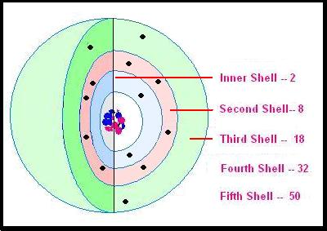

Slide 23
Determining shell capacity
2 * (the shell number *the shell number)= the maximum number of electrons in this shell.
Look!
Shell Number 2 * (the shell number * the shell number)
= the maximum number of electrons in this shell.
Maximum Number of Electrons in the Shell
Shell 1 is 2 x (1 x 1) = 2 and 2 x 1 = 2
Shell 2 is 2 x (2 x 2) = 8 and 2 x 4 = 8
Shell 3 is 2 x ( 3 x 3) = 18 and 2 x 9 = 18
Shell 4 is 2 x (4 x 4) = 32 and 2 x 16 = 32
Shell 5 is 2 x (5 x 5) = 50 and 2 x 25 = 50

Slide 24
There are five possible shells available to atoms. This diagram shows only three shells, and some atoms, such as the little hydrogen atom, use only the one inner shell. Each of the elements has a different number of the tiny electrons, and a corresponding number of protons. Hydrogen is the smallest, with only one electron. Carbon, nitrogen, and oxygen, are also small, light atoms.
These electron shells are filled one by one from the inner shell going outward. When a shell has a few atoms in it but is not filled, the atom will connect to another atom that also has shells that are not filled. This is sort of "Plug and Play" system that allows elements to combine in numberless ways. Several atoms can connect to one or more other atoms at once.
Now, what if an atom has space in its outermost track for more electrons than it actually has? This is where we suddenly see that we have a 'Construct a Universe" kit! Atoms combine to fill up the spaces in their shells so that the outer shell is complete. Let's see how that works.

Slide 26
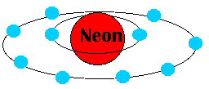
This is a diagram of an atom of neon gas. I have colored the nucleus orange and the electrons blue. The inner shell is filled by two electrons. The next shell is filled too -- with eight electrons. Neon doesn't need any more electrons to fill its outermost shell, so it doesn't participate in chemical reactions. It is what we call an inert gas, one that doesn't combine with other elements.

Slide 27
Now we see a very different situation. Here we have a carbon atom near two hydrogen atoms. Note that the carbon atom has two electrons in the inner ring: that is filled. But in the next ring, it has four empty spaces! The hydrogen atoms, too, could each use another electron.

Slide 28
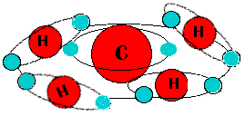
Now lets look at some more atoms. Here we see that four hydrogen atoms are sharing their electrons with the carbon atom! They have filled the empty ring spaces in the carbon atom, and the carbon atom is sharing its electrons as well. We now have a molecule of methane gas! This is real chemistry

Slide 29
Actually, carbon is an amazing element. It can make long chains with its own atoms, and with other atoms that it can add to the chain. The complex molecules that life forms need are built around carbon atoms and chains.

