Slide 1
Introduction to Electricity
Chapter 17

Slide 2
Section 1 – Electric charge and Static Electricity
Terms to Learn
Law of Electric Charges
Electric Force
Conduction
Induction
Conductor
Insulator
Static Electricity
Electric Discharge

Slide 3
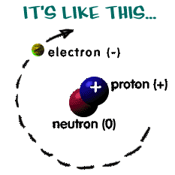
Atoms and Charge
Remember: Atoms are made of protons, electrons, and neutrons
Protons have a positive charge
Electrons have a negative charge
Neutrons have no charge
Protons and neutrons are found in the nucleus whereas electrons are found outside the nucleus

Slide 4
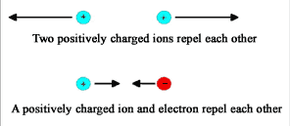
Charges
Charge is a physical property which exerts a push or a pull on another charged object
Positive or negative charge
Law of electric charge – like charges repel and opposite charges attract
Electrons are attracted to protons which is what holds the nucleus together

Slide 5
Electric Force
Electric Force is the force between charged objects
How strong the force is depends on two things
The size of the charges
The greater the charges the electric force
The distance between the charges
the closer the charges are the greater the electric force
Electric field – a region around a charged particle that can exert a force on another charged particle
If a charged particle is in the field of another charged particle the first particle will be repelled or attracted by the electric force exerted on it

Slide 6
Charge it
Most atoms are neutral because the protons equal the number of electrons.
To charge an object you must change the number of electrons
If the atom loses an electron it becomes positively charged
If an atom gains electrons it becomes negatively charged
Three ways for an object to become charged
1. Friction
2. Conduction
3. Induction
An electroscope can measure charge
When an object is charged by any method charges are neither created nor destroyed

Slide 7
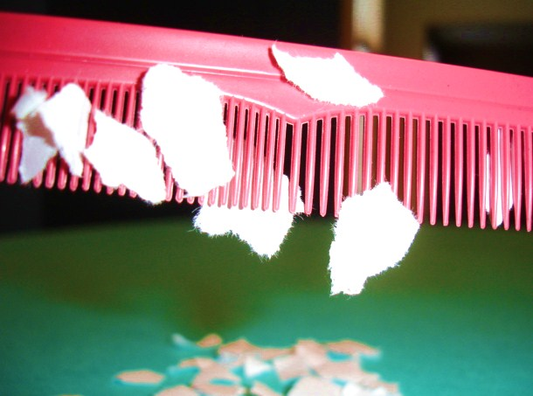
Friction
Rubbing two electrons together causes electrons to be transferred from one object to the next. The one that gains electrons becomes negatively charged. The ones that loses electrons becomes positively charged

Slide 8
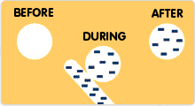
Conduction
Conduction – occurs when electrons are transferred from one object to another by direct contact.

Slide 9
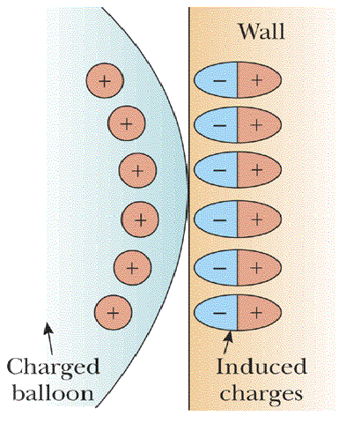
Induction
Induction – occurs when charges in an uncharged object are rearranged without direct contact with a charged object.

Slide 10
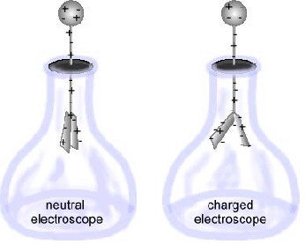
Conservation of charge
When you charge objects be any method charges are not created or destroyed. Electrons simply move from one object to another creating area of different charge.
Detecting charge – To see if something is charged you can use an electroscope

Slide 11
Conductors vs Insulators
Conductors – material is which charges can move easily. Most metals are good conductors because some of the electrons in metals are free to move about. That is why the prongs of a plug are metal.
Copper, silver ,aluminum, and mercury are good conductors. Tap water is also a good conductor.
Insulators – material in which charges cannot move easily. Do not conduct charged very well because electrons are tightly bound to the atoms of the insulator and cannot flow freely. Plastic, wood, glass, rubber, and air are all good insulators
Most conductors are surrounded by an insulator.

Slide 12
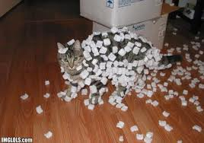
Static Electricity
Static electricity is the build up of charges on an object. Static means that it is not moving os the charges stay on the object. Clothes are an insulator so when the friction from the dryer charges them they stay charged.

Slide 13
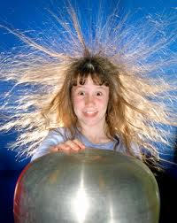
Electric Discharge
Charges that build up as static electricity eventually leave the object. This static electricity moving off the object is called electric discharge.
Clothes will eventually lose their static electricity because their electric charges are transferred to water molecules over time.
Other discharges happen fast like when you shock yourself.

Slide 14
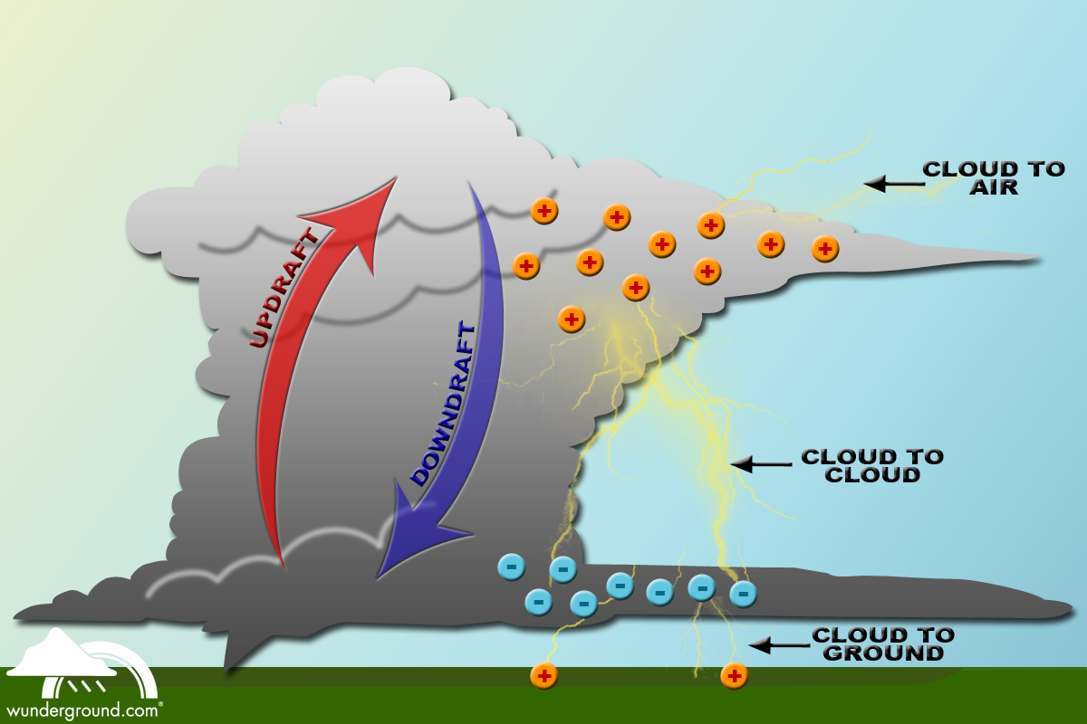
Lightning

Slide 15
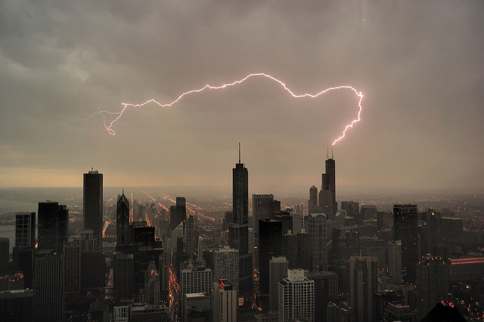
Lightning Rods
Benjamin Franklin was the first to discover that lightning was a form of electricity. He also invented lightning rods.
Lightning rods are pointed rods connected to the ground with a wire. Lightning usually strikes the highest point because it provides the easiest path for the charges to reach the ground. They are the highest point on the building and are grounded. Don’t be the highest thing in the area.

Slide 16
Section 2 – Electrical Energy
Terms to Learn
- Cell
- Battery
- Potential Energy
- Photocell
- Thermocouple

Slide 17
Batteries
Energy is defined as the ability to do work; Remember that energy is neither created nor destroyed it only changes to other types of energy
Cell – device that produces an electric current by converting chemical energy into electrical energy
Battery – also converts chemical energy into electrical energy and is made of several cells
Cells contain a mixture of chemicals that conducts a current; the mixture is called an electrolyte;
1. chemical reactions in the electrolyte convert electrical into electrical energy
2. every cell also contains a pair of electrodes made from two different conducting materials that are in contact with the electrolytes
3. electrode is the part of the cell through which charges enter or exit

Slide 18
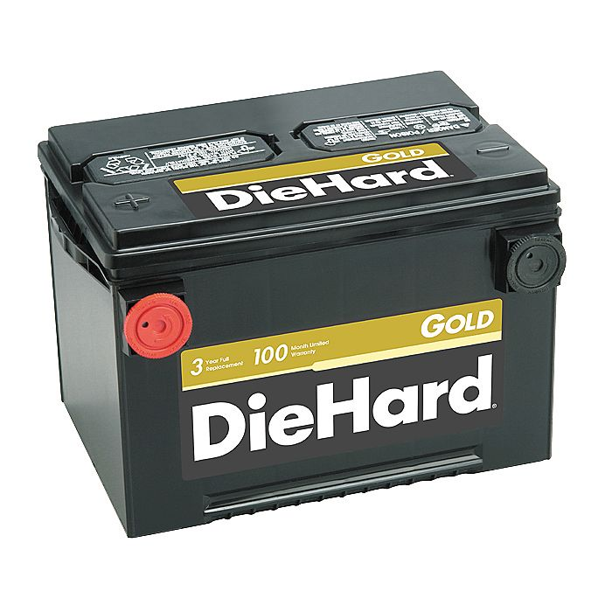
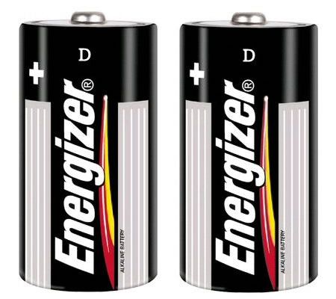
Types of Cells
Two types of cells: wet and dry
Wet cells contain liquid electrolytes ex. Car batteries use sulfuric acid
Dry cells contain solid or paste-like electrolytes ex. flashlights

Slide 19
Potential
Why does the electric current exist between the electrodes?
Because the chemical reaction causes a difference in charge between the two electrodes
This difference in charge between the two electrodes means that an electric current ( a flow of electric charge) can be produced by the cell to provide energy
Potential difference – the energy per unit charge and is expressed in volts (V)
As long as there is a potential difference between the electrodes and a wire connecting them then a current will flow creating a current
The greater the potential difference the greater the current
This causes the difference in voltage.

Slide 20
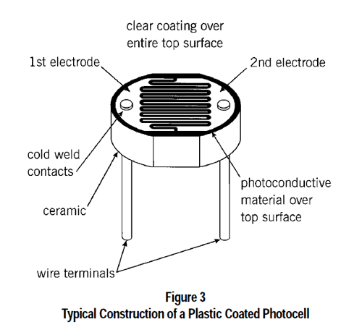
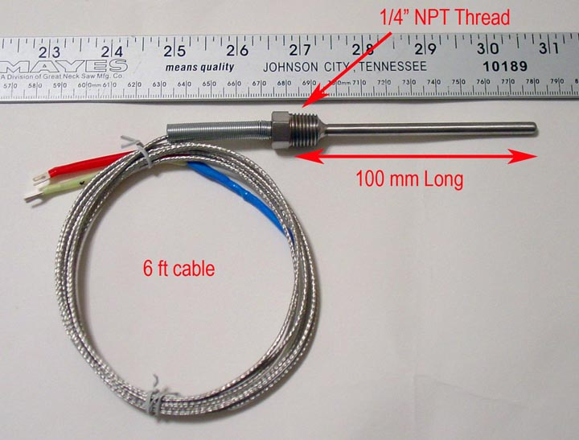
Producing electrical energy
There are several ways that chemical energy can be converted to electrical energy
Photocells – the part of a solar panel that converts light into electrical energy
Thermocouples – joining wires made of two different metals into a loop; the difference within the loop causes charges to flow through the loop
Thermocouples are used to monitor the temperature of car engines and ovens

Slide 21
Section 3 – Electric Current
Terms to Learn
- Current
- Voltage
- Resistance
- Electric Power

Slide 22
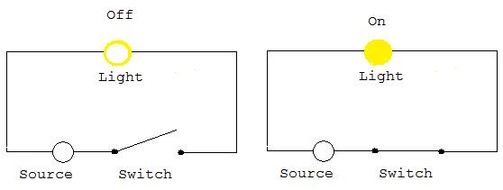
The power you use at home
Current – is more precisely defines as the rate at which charges pass over a given point
- The higher the current is the more charge passes the point each second. The unit for current is ampere or amp and the symbol is I

Slide 23
AC/DC
Two types of currents
-Alternating current – The current continuously changes from one direction to the reverse direction ex. The light switches in your house run in both direction and change direction 120 times per second`
-Direct Current – The current always runs in the same direction ex. batteries

Slide 24
Voltage
Voltage – difference in energy per unit charge as a charge moves between two points in the path of a current. Voltage is another word for potential difference. Measured in volts and the symbol is V. The higher the voltage the more energy released per charge. Voltage is 120 in the US and runs things like the TV and toasters. Flashlights and lesser electronics need a lower voltage like a 3v.

Slide 25
 | Current | Voltage
Definition: | Current is the rate at which electric charge flows past a point in a circuit. In other words, current is the rate of flow of electric charge. | Voltage, also called electromotive force, is the potential difference in charge between two points in an electrical field. In other words, voltage is the "energy per unit charge”.
Symbol: | I | V
Measuring Instrument: | Ammeter | Voltmeter
Unit: | A or amps or ampere | V or volts or voltage
SI Unit: | 1 ampere =1 coulomb/second. | 1 volt = 1 joule/coulomb.
Relationship: | Effect | Cause
Dependence: | Current cannot flow without Voltage | Voltage can exist without current.
In series connection: | Current is the same through all components connected in series. | Voltage gets distributed over components connected in series.
In a parallel connection: | Current gets distributed over components connected in parallel. | Voltages are the same across all components connected in parallel.
Field created: | A magnetic field | An electrostatic field

Slide 26
Resistance
Resistance is the opposition to the flow of electric charge. Resistance is expressed in ohms Ω and is the response to the collisions with the atoms in the material
-Works like electrical friction, the higher the resistance the lower the current flow. Resistance varies depending on material, thickness, length, and temperature
Material – Good conductors have low resistance. Poor conductors have higher resistance. Insulators have so much resistance that current can not flow through them at all
Thickness and Length – The shorter the wire the less resistance and the thicker the wire the less resistance
Temperature – The resistance of metals increases as temperature increases because atoms mover faster as temperature increases and get in the way of flowing electrons
If you drop a certain metals temperature resistance will drop to nearly 0 this is a superconductor . Hardly any energy is wasted in the flow if the current but it takes so much energy to cool them that they are not practical for everyday use.

Slide 27
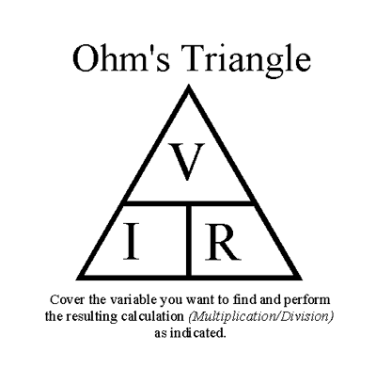
Ohm’s Law
Ohm's Law:
Amperes (A) = volts (V) / Ohms (Ω)
I = V / R

Slide 28
Electric Power
Electric Power – is the rate at which electrical energy is used to do work. The unit is watt (W) and the symbol is the letter P
Power = voltage x current or P= V x I
Watts (W) = volts (V) x amperes (A)

Slide 29
What is a watt?
Light bulbs are categorized by watts. The higher the wattage the brighter the bulb.
Higher wattage is expressed in kilowatts (kW) 1 kilowatt is equal to 1000 watts.
You get charged by how much power you use and how long you use it
Electrical energy = power x time

Slide 30
Section 4 – Electric currents
Terms to Learn
Circuit
Load
Series Circuit
Parallel Circuit

Slide 31
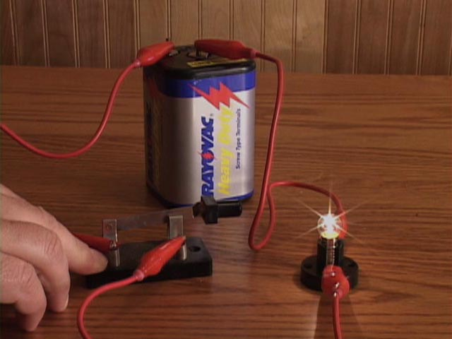
Circuits
Electric charges need a path to follow and this is called a circuit
A circuit is a complete, closed path through which electric charges flow
Parts of a circuit
Energy source, a load, and wires to connect the other parts together
Load – a device that uses electrical energy to do work

Slide 32
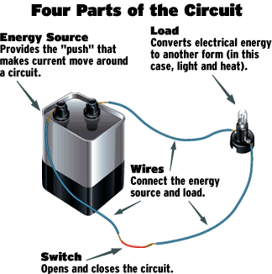
Opening and closing a circuit
Sometimes a circuit includes a switch which can open and close the circuit
Switches are usually made of conducting material so when they are open the conducting material does not touch and the circuit is not complete. When the switch is closed the material touches completing the circuit.

Slide 33
Types of Circuits
Most circuits contain more than one load and may include several rooms worth of loads
Two types: Series – circuit where all parts are connected in a single loop
Parallel – a circuit where different loads are located on different branches

Slide 34
Series Circuit
All the loads in a series circuit share the same current and therefore share the same power. If you added more loads there would be more resistance and the power to each load would decrease.
Uses – For charges to flow all the loads must be turned on and working. If one load is not working then none will work.
Useful in bank alarms, street lights

Slide 35
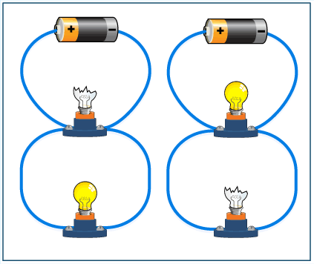
Parallel Circuits
If you had a series in your house then to turn on a light in the bedroom you would need every light in the house on. In a parallel circuit different loads are on different circuits so they travel through more than one path.
Each load carries a different current but has the same voltage so no matter how many lights are attached they all shine a full brightness. You can plug in something that requires a higher voltage to the same plug as something that requires a lower voltage.
Uses – Since one circuits does not have any effect on another if one is broken then the others still work. So if a light bulb goes out then your TV will still work.

